Slide 1

AN ARBITRARY-ORDER ENERGY– AND MAGNETIC MOMENT–STABLE INTEGRATOR FOR CHARGED PARTICLES
Boris Andrews | Patrick Farrell
CHaRMNET Self-Consistency Group seminar
June 3rd 2025
Notes:
Thanks for having me/giving me the opportunity to talk to you today about some exciting work
I’m a PhD student at Oxford, in my final month, under the supervision of Patrick Farrell --- touch wood, I should be submitting my thesis in a month, wherein this work can be found
My interests lie primarily in structure-preserving methods for PDEs so I’m not so much in the field, however I discovered the Lorentz problem through my work with UKAEA and I’ve found some interesting applications of my work in this problem

Slide 2
AN ARBITRARY-ORDER ENERGY– AND MAGNETIC MOMENT–STABLE INTEGRATOR FOR CHARGED PARTICLES
Boris Andrews | Patrick Farrell
CHaRMNET Self-Consistency Group seminar
June 3rd 2025
Notes:
In particular, what I’ll be talking about today is magnetic moment stability, i.e. preserving the asymptotic behaviour of the magnetic moment
I’ve been able to repurpose some of my work to tackle this in a way that is (theoretically) uniformly accurate, i.e. works across all timescales, and furthermore relies only on a clever rewriting and discretisation of the equations, and not on the introduction of any fictitious forces or velocities
The way I do this is very general, and could theoretically be extended to adiabatic invariants for other systems, beyond the magnetic moment
In particular, I realise the holy grail here is the preservation of the guiding centre drifts; while the scheme I propose does not preserve these drifts (☹) the same ideas get you about 70-80% of the way there (as I shall demonstrate at the end!) so this is both completed work that shall appear in my thesis very soon, but also the opening of a new avenue for tackling the problem of asymptotic preservation
So, without further ado…

Slide 3
1. HAMILTONIAN & POISSON SYSTEMS

Slide 4
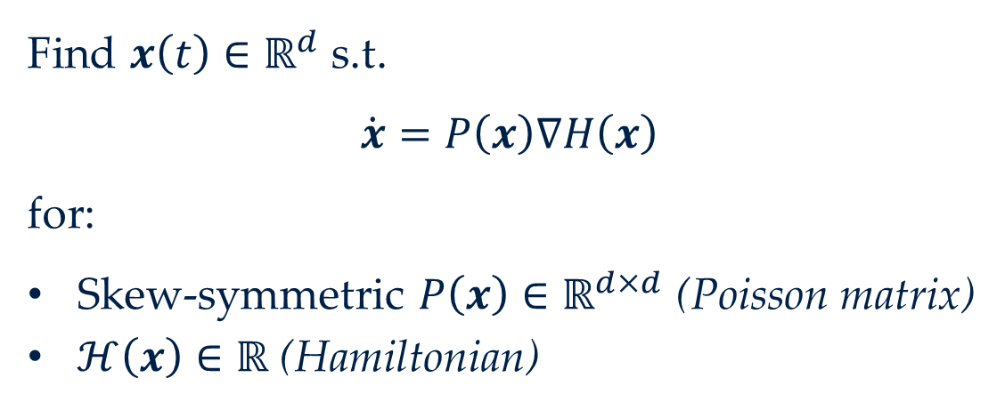
Definition (Poisson system)
Find $x\left(t\right)∈ℝ^{d}$ s.t.
$$\dot{x}=P\left(x\right)∇H\left(x\right)$$
for:
Skew-symmetric $P\left(x\right)∈ℝ^{d×d}$ (Poisson matrix)
$ℋ\left(x\right)∈ℝ$ (Hamiltonian)

Slide 5
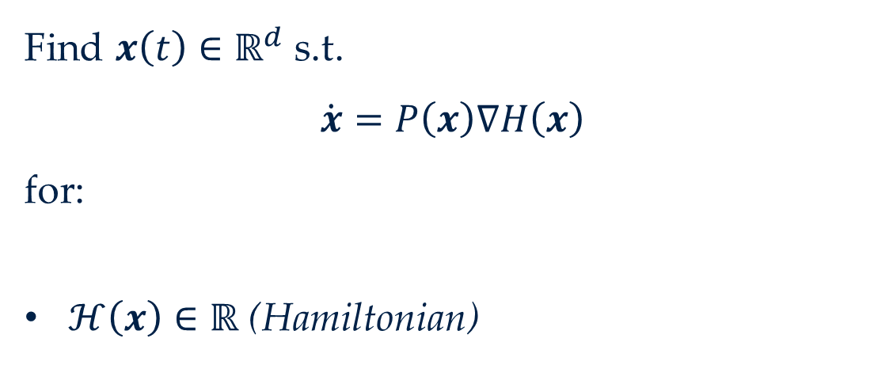
Definition (Poisson system)
Find $x\left(t\right)∈ℝ^{d}$ s.t.
$$\dot{x}=P\left(x\right)∇H\left(x\right)$$
for:
Skew-symmetric $P\left(x\right)∈ℝ^{d×d}$ (Poisson matrix)
$ℋ\left(x\right)∈ℝ$ (Hamiltonian)
Encodes the Poisson bracket

Slide 6

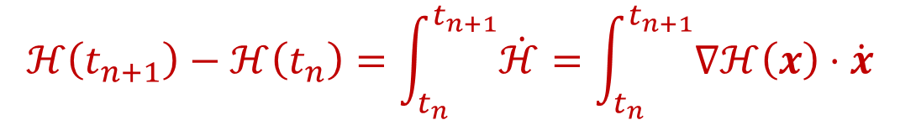
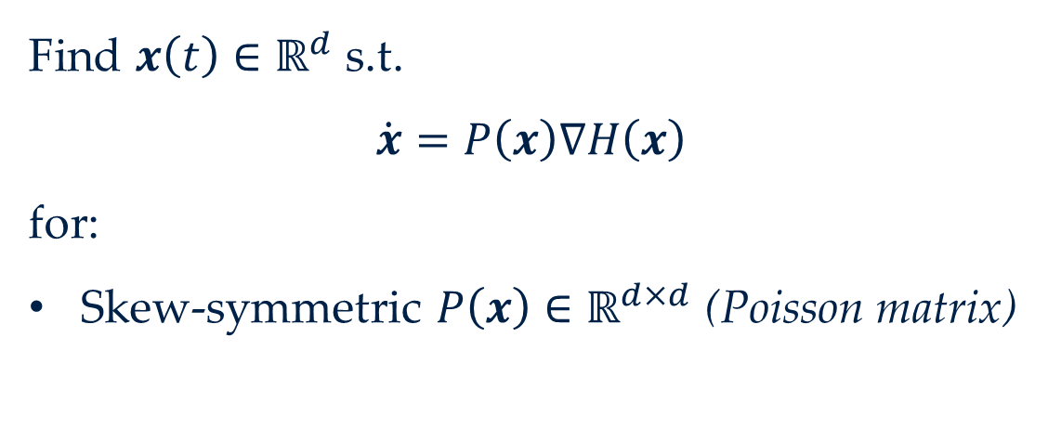
Definition (Poisson system)
Find $x\left(t\right)∈ℝ^{d}$ s.t.
$$\dot{x}=P\left(x\right)∇H\left(x\right)$$
for:
Skew-symmetric $P\left(x\right)∈ℝ^{d×d}$ (Poisson matrix)
$ℋ\left(x\right)∈ℝ$ (Hamiltonian)
Conserved
$$ℋ\left(t_{n+1}\right)−ℋ\left(t_{n}\right)=\int_{t_{n}}^{t_{n+1}}{\dot{ℋ}}=\int_{t_{n}}^{t_{n+1}}{∇ℋ\left(x\right)⋅\dot{x}}$$

Slide 7

Definition (Poisson system)
Find $x\left(t\right)∈ℝ^{d}$ s.t.
$$\dot{x}=P\left(x\right)∇H\left(x\right)$$
for:
Skew-symmetric $P\left(x\right)∈ℝ^{d×d}$ (Poisson matrix)
$ℋ\left(x\right)∈ℝ$ (Hamiltonian)
Conserved
$$ℋ\left(t_{n+1}\right)−ℋ\left(t_{n}\right)=\int_{t_{n}}^{t_{n+1}}{\dot{ℋ}}=\int_{t_{n}}^{t_{n+1}}{∇ℋ\left(x\right)⋅\dot{x}}$$

Slide 8
Definition (Poisson system)
Find $x\left(t\right)∈ℝ^{d}$ s.t.
$$\dot{x}=P\left(x\right)∇H\left(x\right)$$
for:
Skew-symmetric $P\left(x\right)∈ℝ^{d×d}$ (Poisson matrix)
$ℋ\left(x\right)∈ℝ$ (Hamiltonian)
Conserved
$$ℋ\left(t_{n+1}\right)−ℋ\left(t_{n}\right)=\int_{t_{n}}^{t_{n+1}}{\dot{ℋ}}=\int_{t_{n}}^{t_{n+1}}{∇ℋ\left(x\right)⋅\dot{x}}$$

Slide 9
Definition (Poisson system)
Find $x\left(t\right)∈ℝ^{d}$ s.t.
$$\dot{x}=P\left(x\right)∇H\left(x\right)$$
for:
Skew-symmetric $P\left(x\right)∈ℝ^{d×d}$ (Poisson matrix)
$ℋ\left(x\right)∈ℝ$ (Hamiltonian)
Conserved
$$ℋ\left(t_{n+1}\right)−ℋ\left(t_{n}\right)=\int_{t_{n}}^{t_{n+1}}{\dot{ℋ}}=\int_{t_{n}}^{t_{n+1}}{∇ℋ\left(x\right)⋅\dot{x}}$$

Slide 10
Definition (Poisson system)
Find $x\left(t\right)∈ℝ^{d}$ s.t.
$$\dot{x}=P\left(x\right)∇H\left(x\right)$$
for:
Skew-symmetric $P\left(x\right)∈ℝ^{d×d}$ (Poisson matrix)
$ℋ\left(x\right)∈ℝ$ (Hamiltonian)
Conserved
$$ℋ\left(t_{n+1}\right)−ℋ\left(t_{n}\right)=\int_{t_{n}}^{t_{n+1}}{\dot{ℋ}}=\int_{t_{n}}^{t_{n+1}}{{∇ℋ\left(x\right)}^{⊤}\dot{x}}=\int_{t_{n}}^{t_{n+1}}{{∇ℋ\left(x\right)}^{⊤}B\left(x\right)∇ℋ\left(x\right)}=0$$

Slide 11
Definition (Poisson system)
Find $x\left(t\right)∈ℝ^{d}$ s.t.
$$\dot{x}=P\left(x\right)∇H\left(x\right)$$
for:
Skew-symmetric $P\left(x\right)∈ℝ^{d×d}$ (Poisson matrix)
$ℋ\left(x\right)∈ℝ$ (Hamiltonian)
Conserved
$$ℋ\left(t_{n+1}\right)−ℋ\left(t_{n}\right)=\int_{t_{n}}^{t_{n+1}}{\dot{ℋ}}=\int_{t_{n}}^{t_{n+1}}{{∇ℋ\left(x\right)}^{⊤}\dot{x}}=\int_{t_{n}}^{t_{n+1}}{{∇ℋ\left(x\right)}^{⊤}P\left(x\right)∇ℋ\left(x\right)}=0$$

Slide 12

Definition (Poisson system)
Find $x\left(t\right)∈ℝ^{d}$ s.t.
$$\dot{x}=P\left(x\right)∇H\left(x\right)$$
for:
Skew-symmetric $P\left(x\right)∈ℝ^{d×d}$ (Poisson matrix)
$ℋ\left(x\right)∈ℝ$ (Hamiltonian)
Conserved
$$ℋ\left(t_{n+1}\right)−ℋ\left(t_{n}\right)=\int_{t_{n}}^{t_{n+1}}{\dot{ℋ}}=\int_{t_{n}}^{t_{n+1}}{{∇ℋ\left(x\right)}^{⊤}\dot{x}}=\int_{t_{n}}^{t_{n+1}}{{∇ℋ\left(x\right)}^{⊤}P\left(x\right)∇ℋ\left(x\right)}=0$$
Not all numerical integrators conserve energy $ℋ\left(x\right)$
⚠️ IN PARTICULAR… ⚠️
Symplectic integrators only conserve $ℋ\left(x\right)$when $ℋ$ is quadratic

Slide 13
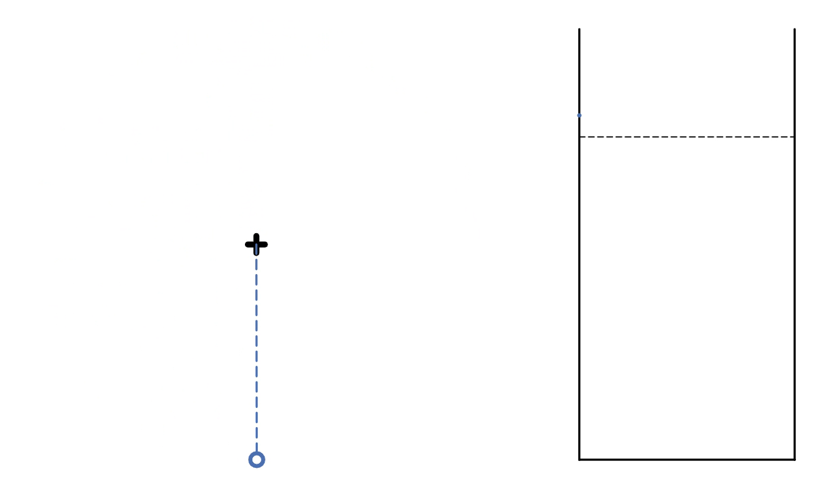

Slide 14
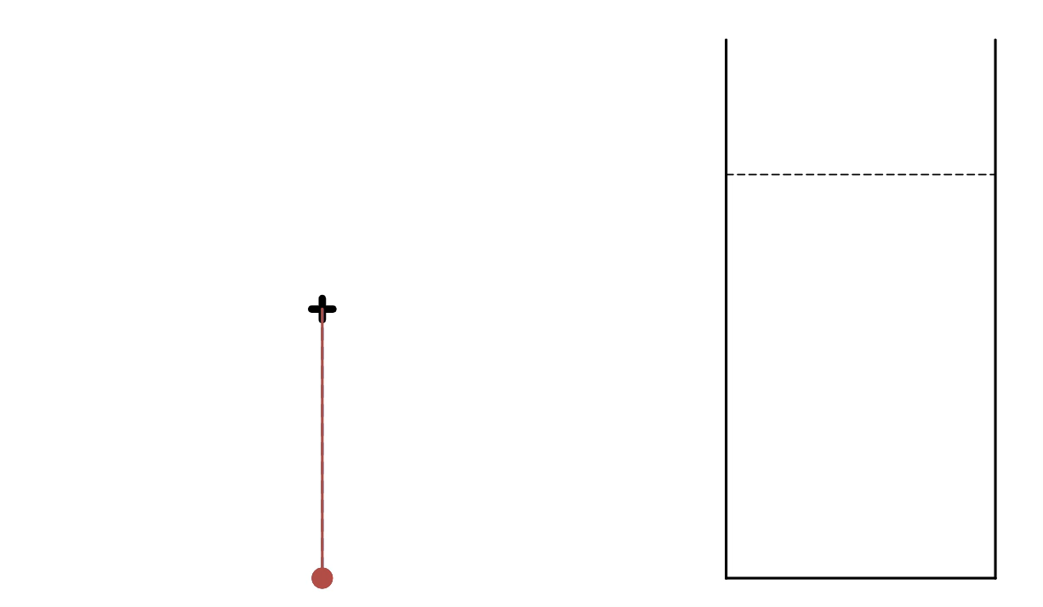
Let’s construct an energy-conserving integrator!
To do that, let’s start from explicit/forward Euler…

Slide 15

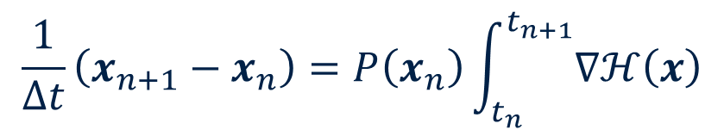
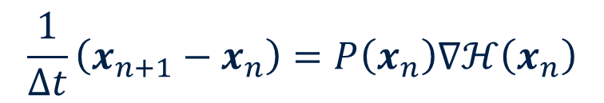


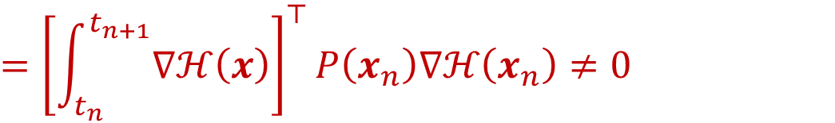

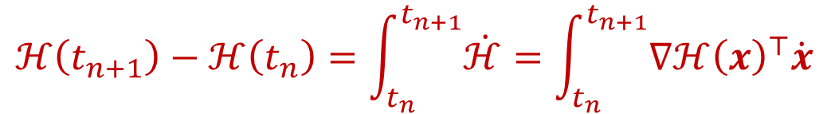
Idea #1 (Explicit Euler)
Idea #2 (Mean-value discrete gradient)
Find $x_{n+1}∈ℝ^{d}$ s.t.
Find $x_{n+1}∈ℝ^{d}$ s.t.
$$\frac{1}{Δt}\left(x_{n+1}−x_{n}\right)=P\left(x_{n}\right)∇ℋ\left(x_{n}\right)$$
$$\frac{1}{Δt}\left(x_{n+1}−x_{n}\right)=P\left(x_{n}\right)\int_{t_{n}}^{t_{n+1}}{∇ℋ\left(x\right)}$$
$$ℋ\left(t_{n+1}\right)−ℋ\left(t_{n}\right)=\int_{t_{n}}^{t_{n+1}}{\dot{ℋ}}=\int_{t_{n}}^{t_{n+1}}{{∇ℋ\left(x\right)}^{⊤}\dot{x}}$$
$$={\left[\int_{t_{n}}^{t_{n+1}}{∇ℋ\left(x\right)}\right]}^{⊤}\frac{1}{Δt}\left(x_{n+1}−x_{n}\right)$$
$$={\left[\int_{t_{n}}^{t_{n+1}}{∇ℋ\left(x\right)}\right]}^{⊤}P\left(x_{n}\right)∇ℋ\left(x_{n}\right)≠0$$

Slide 16



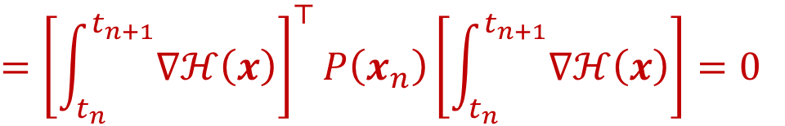
Idea #1 (Explicit Euler)
Idea #2 (Mean-value discrete gradient)
Find $x_{n+1}∈ℝ^{d}$ s.t.
Find $x_{n+1}∈ℝ^{d}$ s.t.
$$\frac{1}{Δt}\left(x_{n+1}−x_{n}\right)=P\left(x_{n}\right)∇ℋ\left(x_{n}\right)$$
$$\frac{1}{Δt}\left(x_{n+1}−x_{n}\right)=P\left(x_{n}\right)\int_{t_{n}}^{t_{n+1}}{∇ℋ\left(x\right)}$$
$$ℋ\left(t_{n+1}\right)−ℋ\left(t_{n}\right)=\int_{t_{n}}^{t_{n+1}}{\dot{ℋ}}=\int_{t_{n}}^{t_{n+1}}{{∇ℋ\left(x\right)}^{⊤}\dot{x}}$$
$$={\left[\int_{t_{n}}^{t_{n+1}}{∇ℋ\left(x\right)}\right]}^{⊤}\frac{1}{Δt}\left(x_{n+1}−x_{n}\right)$$
$$={\left[\int_{t_{n}}^{t_{n+1}}{∇ℋ\left(x\right)}\right]}^{⊤}P\left(x_{n}\right)\left[\int_{t_{n}}^{t_{n+1}}{∇ℋ\left(x\right)}\right]=0$$

Slide 17
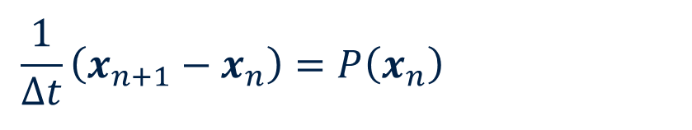
Idea #1 (Explicit Euler)
Idea #2 (Mean-value discrete gradient)
Find $x_{n+1}∈ℝ^{d}$ s.t.
Find $x_{n+1}∈ℝ^{d}$ s.t.
$$\frac{1}{Δt}\left(x_{n+1}−x_{n}\right)=P\left(x_{n}\right)∇ℋ\left(x_{n}\right)$$
$$\frac{1}{Δt}\left(x_{n+1}−x_{n}\right)=P\left(x_{n}\right)\int_{t_{n}}^{t_{n+1}}{∇ℋ\left(x\right)}$$
$$ℋ\left(t_{n+1}\right)−ℋ\left(t_{n}\right)=\int_{t_{n}}^{t_{n+1}}{\dot{ℋ}}=\int_{t_{n}}^{t_{n+1}}{{∇ℋ\left(x\right)}^{⊤}\dot{x}}$$
$$={\left[\int_{t_{n}}^{t_{n+1}}{∇ℋ\left(x\right)}\right]}^{⊤}\frac{1}{Δt}\left(x_{n+1}−x_{n}\right)$$
$$={\left[\int_{t_{n}}^{t_{n+1}}{∇ℋ\left(x\right)}\right]}^{⊤}P\left(x_{n}\right)\left[\int_{t_{n}}^{t_{n+1}}{∇ℋ\left(x\right)}\right]=0$$

Slide 18



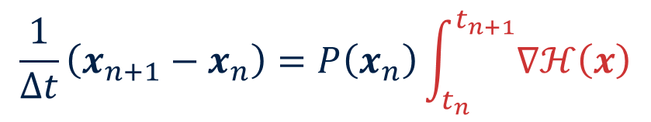

Idea #1 (Explicit Euler)
Idea #2 (Mean-value discrete gradient)
Find $x_{n+1}∈ℝ^{d}$ s.t.
Find $x_{n+1}∈ℝ^{d}$ s.t.
$$\frac{1}{Δt}\left(x_{n+1}−x_{n}\right)=P\left(x_{n}\right)∇ℋ\left(x_{n}\right)$$
$$\frac{1}{Δt}\left(x_{n+1}−x_{n}\right)=P\left(x_{n}\right)\int_{t_{n}}^{t_{n+1}}{∇ℋ\left(x\right)}$$
$$\tilde{∇ℋ}$$
$$ℋ\left(t_{n+1}\right)−ℋ\left(t_{n}\right)=\int_{t_{n}}^{t_{n+1}}{\dot{ℋ}}=\int_{t_{n}}^{t_{n+1}}{{∇ℋ\left(x\right)}^{⊤}\dot{x}}$$
$$={\left[\int_{t_{n}}^{t_{n+1}}{∇ℋ\left(x\right)}\right]}^{⊤}\frac{1}{Δt}\left(x_{n+1}−x_{n}\right)$$
$$\tilde{∇ℋ}$$
$$={\left[\int_{t_{n}}^{t_{n+1}}{∇ℋ\left(x\right)}\right]}^{⊤}P\left(x_{n}\right)\left[\int_{t_{n}}^{t_{n+1}}{∇ℋ\left(x\right)}\right]=0$$
$$\tilde{∇ℋ}$$
$$\tilde{∇ℋ}$$

Slide 19
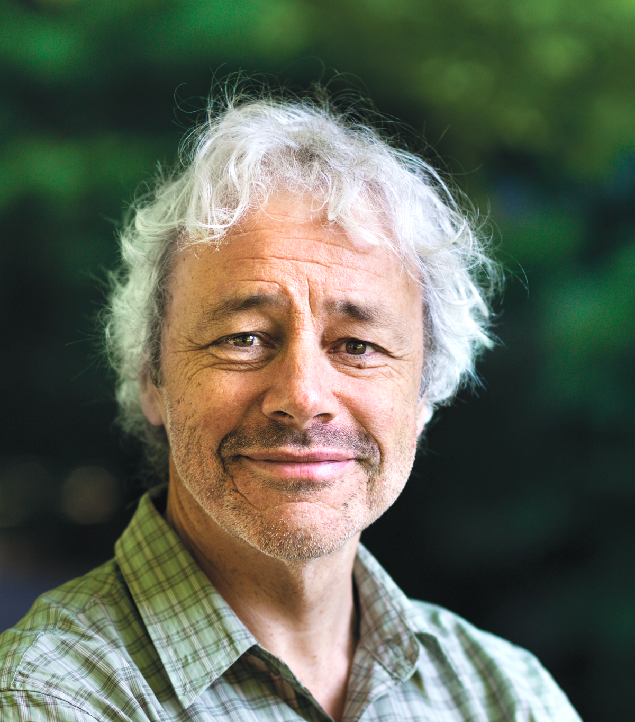
Idea #1 (Explicit Euler)
Idea #2 (Mean-value discrete gradient)
Find $x_{n+1}∈ℝ^{d}$ s.t.
Find $x_{n+1}∈ℝ^{d}$ s.t.
$$\frac{1}{Δt}\left(x_{n+1}−x_{n}\right)=P\left(x_{n}\right)∇ℋ\left(x_{n}\right)$$
$$\frac{1}{Δt}\left(x_{n+1}−x_{n}\right)=P\left(x_{n}\right)\int_{t_{n}}^{t_{n+1}}{∇ℋ\left(x\right)}$$
$$\tilde{∇ℋ}$$
(1999)
$$ℋ\left(t_{n+1}\right)−ℋ\left(t_{n}\right)=\int_{t_{n}}^{t_{n+1}}{\dot{ℋ}}=\int_{t_{n}}^{t_{n+1}}{{∇ℋ\left(x\right)}^{⊤}\dot{x}}$$
Robert McLachlan
$$={\left[\int_{t_{n}}^{t_{n+1}}{∇ℋ\left(x\right)}\right]}^{⊤}\frac{1}{Δt}\left(x_{n+1}−x_{n}\right)$$
$$\tilde{∇ℋ}$$
$$={\left[\int_{t_{n}}^{t_{n+1}}{∇ℋ\left(x\right)}\right]}^{⊤}P\left(x_{n}\right)\left[\int_{t_{n}}^{t_{n+1}}{∇ℋ\left(x\right)}\right]=0$$
$$\tilde{∇ℋ}$$
$$\tilde{∇ℋ}$$

Slide 20
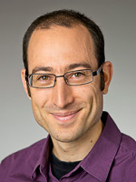
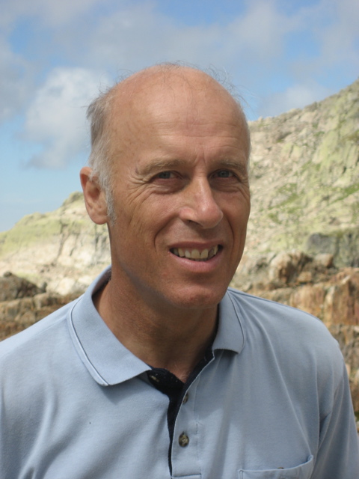
Idea #1 (Explicit Euler)
Idea #2 (Mean-value discrete gradient)
Find $x_{n+1}∈ℝ^{d}$ s.t.
Find $x_{n+1}∈ℝ^{d}$ s.t.
$$\frac{1}{Δt}\left(x_{n+1}−x_{n}\right)=P\left(x_{n}\right)∇ℋ\left(x_{n}\right)$$
$$\frac{1}{Δt}\left(x_{n+1}−x_{n}\right)=P\left(x_{n}\right)\int_{t_{n}}^{t_{n+1}}{∇ℋ\left(x\right)}$$
$$\tilde{∇ℋ}$$
(1999)
$$ℋ\left(t_{n+1}\right)−ℋ\left(t_{n}\right)=\int_{t_{n}}^{t_{n+1}}{\dot{ℋ}}=\int_{t_{n}}^{t_{n+1}}{{∇ℋ\left(x\right)}^{⊤}\dot{x}}$$
David Cohen
Ernst Hairer
Robert McLachlan
$$={\left[\int_{t_{n}}^{t_{n+1}}{∇ℋ\left(x\right)}\right]}^{⊤}\frac{1}{Δt}\left(x_{n+1}−x_{n}\right)$$
$$\tilde{∇ℋ}$$
You can generalise this to arbitrary order!
(2011)
$$={\left[\int_{t_{n}}^{t_{n+1}}{∇ℋ\left(x\right)}\right]}^{⊤}P\left(x_{n}\right)\left[\int_{t_{n}}^{t_{n+1}}{∇ℋ\left(x\right)}\right]=0$$
$$\tilde{∇ℋ}$$
$$\tilde{∇ℋ}$$
Notes:
Everything I say from here can be generalised to arbitrary order in time

Slide 21
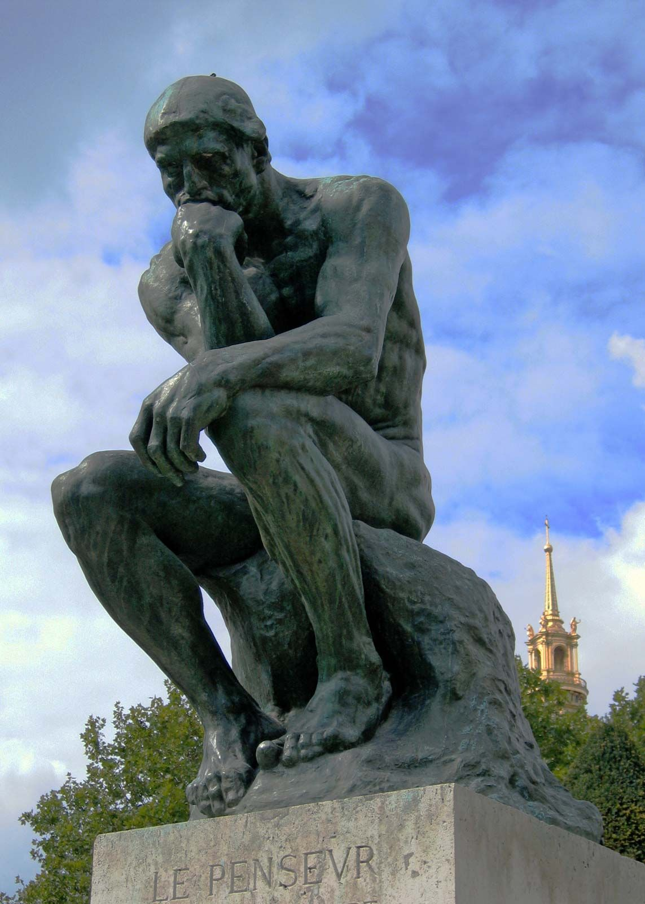
To preserve the structure…
…preserve the proof

Slide 22

To preserve the structure…
…preserve the proof

Slide 23
2. THE LORENTZ PROBLEM

Slide 24
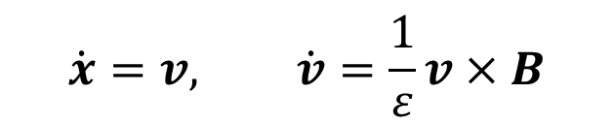
$$\dot{x}=v, \dot{v}=\frac{1}{ε}v×B$$
Notes:
For sake of exposition, I’ll be assuming no electric field and a constant-in-time magnetic field (Both of these will of course be relevant when considering the magnetic moment later…)

Slide 25
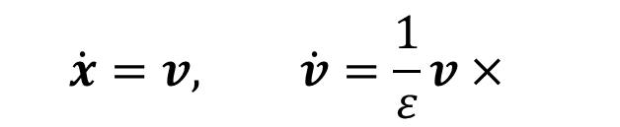

$$\dot{x}=v, \dot{v}=\frac{1}{ε}v×B$$
Supposing $B≔\left\|B\right\|≈1$…

Slide 26
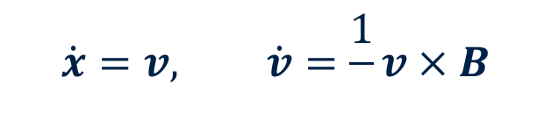
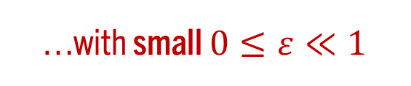
$$\dot{x}=v, \dot{v}=\frac{1}{ε}v×B$$
…with small $0≤ε≪1$

Slide 27
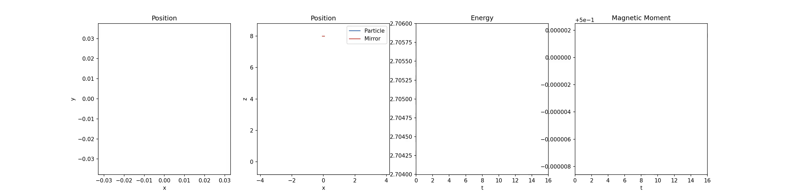
$$\dot{x}=v, \dot{v}=\frac{1}{ε}v×B$$

Slide 28
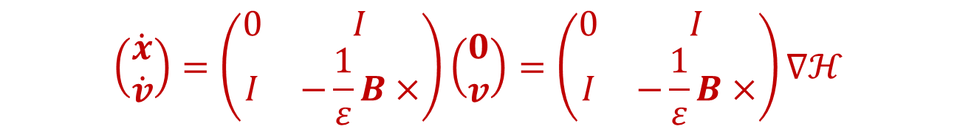
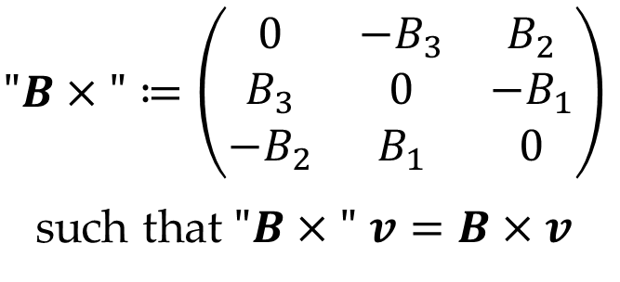
$$\dot{x}=v, \dot{v}=\frac{1}{ε}v×B$$
$$\left(\begin{matrix}\dot{x} \\ \dot{v}\end{matrix}\right)=\left(\begin{matrix}0 & I \\ I & −\frac{1}{ε}B×\end{matrix}\right)\left(\begin{matrix}0 \\ v\end{matrix}\right)=\left(\begin{matrix}0 & I \\ I & −\frac{1}{ε}B×\end{matrix}\right)∇ℋ$$
$$"B×"≔\left(\begin{matrix}0 & −B_{3} & B_{2} \\ B_{3} & 0 & −B_{1} \\ −B_{2} & B_{1} & 0\end{matrix}\right)$$
such that $"B×"$ $v=B×v$

Slide 29
$$\dot{x}=v, \dot{v}=\frac{1}{ε}v×B$$
$$\left(\begin{matrix}\dot{x} \\ \dot{v}\end{matrix}\right)=\left(\begin{matrix}0 & I \\ I & −\frac{1}{ε}B×\end{matrix}\right)\left(\begin{matrix}0 \\ v\end{matrix}\right)=\left(\begin{matrix}0 & I \\ I & −\frac{1}{ε}B×\end{matrix}\right)∇ℋ$$
$$"B×"≔\left(\begin{matrix}0 & −B_{3} & B_{2} \\ B_{3} & 0 & −B_{1} \\ −B_{2} & B_{1} & 0\end{matrix}\right)$$
such that $"B×"$ $v=B×v$

Slide 30

$$\dot{x}=v, \dot{v}=\frac{1}{ε}v×B$$
$$\left(\begin{matrix}\dot{x} \\ \dot{v}\end{matrix}\right)=\left(\begin{matrix}0 & I \\ I & −\frac{1}{ε}B×\end{matrix}\right)\left(\begin{matrix}0 \\ v\end{matrix}\right)=\left(\begin{matrix}0 & I \\ I & −\frac{1}{ε}B×\end{matrix}\right)∇ℋ$$
Conserves energy $ℋ\left(x,v\right)≔\frac{1}{2}{\left\|v\right\|}^{2}$

Slide 31
$$\dot{x}=v, \dot{v}=\frac{1}{ε}v×B$$
$$\left(\begin{matrix}\dot{x} \\ \dot{v}\end{matrix}\right)=\left(\begin{matrix}0 & I \\ I & −\frac{1}{ε}B×\end{matrix}\right)\left(\begin{matrix}0 \\ v\end{matrix}\right)=\left(\begin{matrix}0 & I \\ I & −\frac{1}{ε}B×\end{matrix}\right)∇ℋ$$
Scheme #1 (Mean value discrete gradient)
Find $x_{n+1},v_{n+1}∈ℝ^{3}$ s.t.
$$\frac{1}{Δt}\left(x_{n+1}−x_{n}\right)=v_{n+1/2}, \frac{1}{Δt}\left(v_{n+1}−v_{n}\right)=\frac{1}{ε}v_{n+1/2}×B\left(x_{n}\right)$$

Slide 32
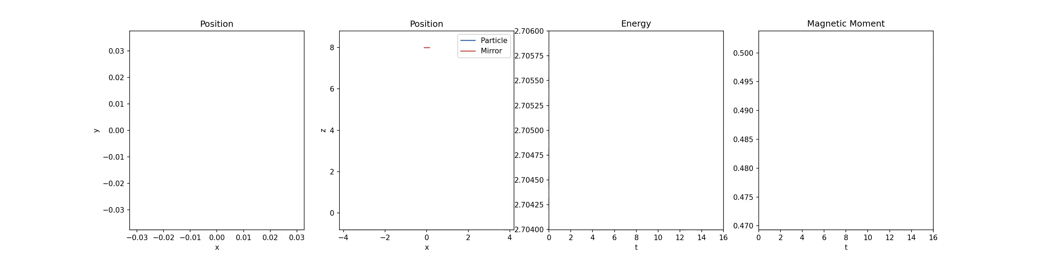
Scheme #1 (Mean value discrete gradient)
Find $x_{n+1},v_{n+1}∈ℝ^{3}$ s.t.
$$\frac{1}{Δt}\left(x_{n+1}−x_{n}\right)=v_{n+1/2}, \frac{1}{Δt}\left(v_{n+1}−v_{n}\right)=\frac{1}{ε}v_{n+1/2}×B\left(x_{n}\right)$$

Slide 33
3. THE MAGNETIC MOMENT

Slide 34




$$v$$
$$B$$
$$b_{||}$$
$$B$$

Slide 35
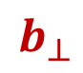
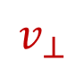
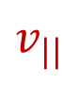


$$v$$
Definition (Magnetic moment)
$$μ≔\frac{1}{2B}v_{⊥}^{2}$$
$$b_{⊥}$$
$$B$$
$$v_{⊥}$$
$$b_{||}$$
$$v_{||}$$
$$B$$

Slide 36

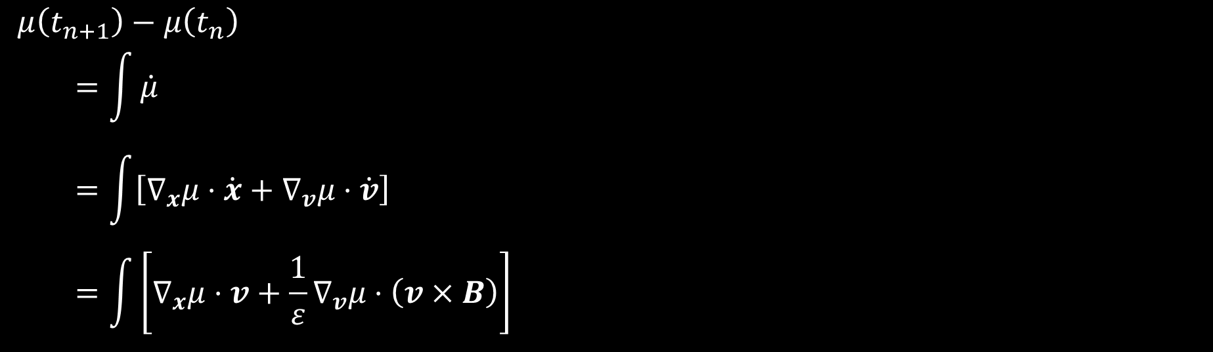
$$μ\left(t_{n+1}\right)−μ\left(t_{n}\right)$$
$$=\int{\dot{μ}}$$
$$=\int{\left[∇_{x}μ⋅\dot{x}+∇_{v}μ⋅\dot{v}\right]}$$
$$=\int{\left[∇_{x}μ⋅v+\frac{1}{ε}∇_{v}μ⋅\left(v×B\right)\right]}$$

Slide 37

$$v$$
Definition (Magnetic moment)
$$μ≔\frac{1}{2B}v_{⊥}^{2}$$
$$b_{⊥}$$
$$B$$
$$v_{⊥}$$
$$b_{||}$$
$$v_{||}$$
$$∇_{v}μ⋅\left(v×B\right)=0$$
$$B$$

Slide 38
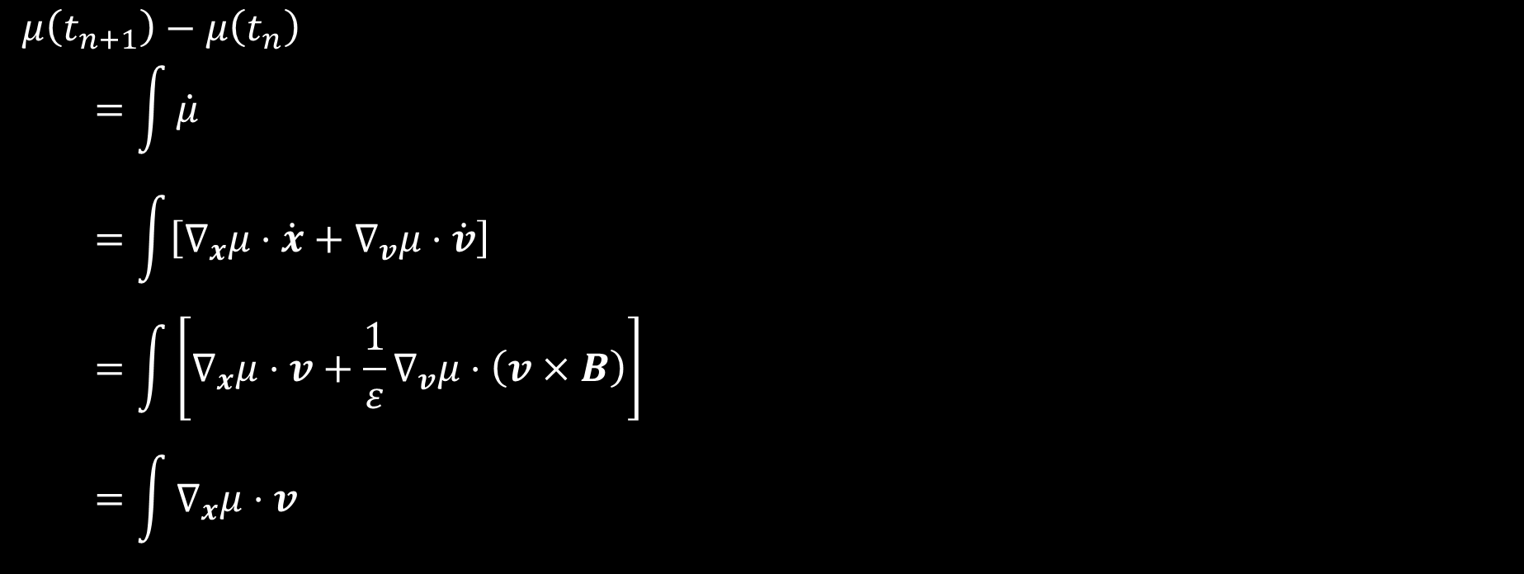
$$μ\left(t_{n+1}\right)−μ\left(t_{n}\right)$$
$$=\int{\dot{μ}}$$
$$=\int{\left[∇_{x}μ⋅\dot{x}+∇_{v}μ⋅\dot{v}\right]}$$
$$=\int{\left[∇_{x}μ⋅v+\frac{1}{ε}∇_{v}μ⋅\left(v×B\right)\right]}$$
$$=\int{∇_{x}μ⋅v}$$

Slide 39

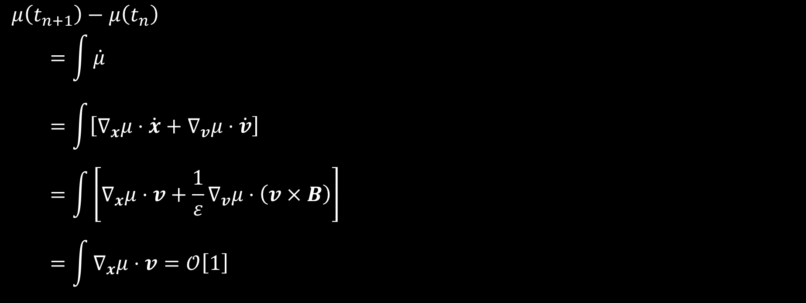
$$μ\left(t_{n+1}\right)−μ\left(t_{n}\right)$$
$$=\int{\dot{μ}}$$
$$=\int{\left[∇_{x}μ⋅\dot{x}+∇_{v}μ⋅\dot{v}\right]}$$
$$=\int{\left[∇_{x}μ⋅v+\frac{1}{ε}∇_{v}μ⋅\left(v×B\right)\right]}$$
$$=\int{∇_{x}μ⋅v}=𝒪\left[1\right]$$

Slide 40
$$v$$
Definition (Magnetic moment)
$$μ≔\frac{1}{2B}v_{⊥}^{2}$$
$$b_{⊥}$$
$$B$$
$$v_{⊥}$$
$$b_{||}$$
$$v_{||}$$
$$∇_{v}μ⋅\left(v×B\right)=0$$
$$B$$
Definition (Magnetic moment correction)
$$δμ≔\frac{1}{B^{3}}\left[v_{||}^{2}v_{⊥}\left(\frac{1}{4}b_{⊥}⊗b_{∗}+\frac{1}{4}b_{∗}⊗b_{⊥}+b_{∗}⊗b_{||}\right)+\frac{1}{2}v_{||}^{3}\left(b_{||}⊗b_{∗}\right)\right]:∇B$$

Slide 41
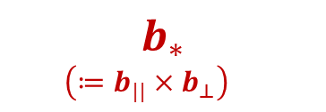
$$v$$
Definition (Magnetic moment)
$$μ≔\frac{1}{2B}v_{⊥}^{2}$$
$$b_{⊥}$$
$$B$$
$$v_{⊥}$$
$$b_{||}$$
$$b_{∗}$$
$$\left(≔b_{||}×b_{⊥}\right)$$
$$v_{||}$$
$$∇_{v}μ⋅\left(v×B\right)=0$$
$$B$$
Definition (Magnetic moment correction)
$$δμ≔\frac{1}{B^{3}}\left[v_{||}^{2}v_{⊥}\left(\frac{1}{4}b_{⊥}⊗b_{∗}+\frac{1}{4}b_{∗}⊗b_{⊥}+b_{∗}⊗b_{||}\right)+\frac{1}{2}v_{||}^{3}\left(b_{||}⊗b_{∗}\right)\right]:∇B$$

Slide 42
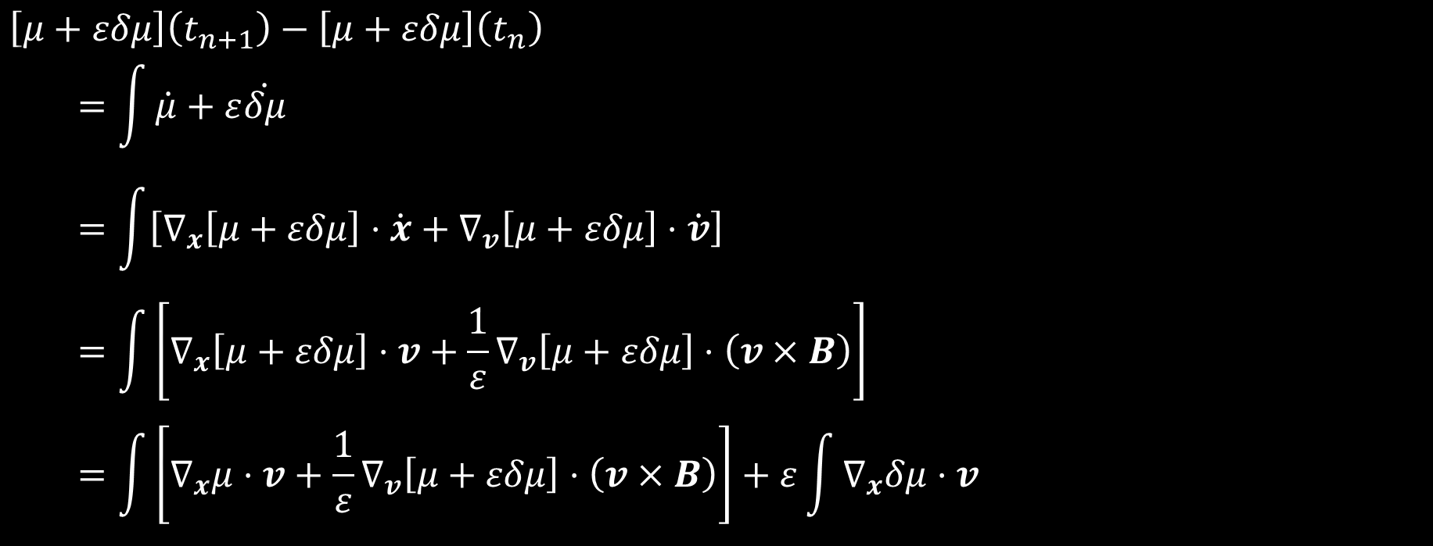
$$\left[μ+εδμ\right]\left(t_{n+1}\right)−\left[μ+εδμ\right]\left(t_{n}\right)$$
$$=\int{\dot{μ}+ε\dot{δμ}}$$
$$=\int{\left[∇_{x}\left[μ+εδμ\right]⋅\dot{x}+∇_{v}\left[μ+εδμ\right]⋅\dot{v}\right]}$$
$$=\int{\left[∇_{x}\left[μ+εδμ\right]⋅v+\frac{1}{ε}∇_{v}\left[μ+εδμ\right]⋅\left(v×B\right)\right]}$$
$$=\int{\left[∇_{x}μ⋅v+\frac{1}{ε}∇_{v}\left[μ+εδμ\right]⋅\left(v×B\right)\right]}+ε\int{∇_{x}δμ⋅v}$$

Slide 43
$$v$$
Definition (Magnetic moment)
$$μ≔\frac{1}{2B}v_{⊥}^{2}$$
$$b_{⊥}$$
$$B$$
$$v_{⊥}$$
$$b_{||}$$
$$b_{∗}$$
$$\left(≔b_{||}×b_{⊥}\right)$$
$$v_{||}$$
$$∇_{v}μ⋅\left(v×B\right)=0$$
$$B$$
Definition (Magnetic moment correction)
$$δμ≔\frac{1}{B^{3}}\left[v_{||}^{2}v_{⊥}\left(\frac{1}{4}b_{⊥}⊗b_{∗}+\frac{1}{4}b_{∗}⊗b_{⊥}+b_{∗}⊗b_{||}\right)+\frac{1}{2}v_{||}^{3}\left(b_{||}⊗b_{∗}\right)\right]:∇B$$

Slide 44


$$v$$
Definition (Magnetic moment)
$$μ≔\frac{1}{2B}v_{⊥}^{2}$$
$$b_{⊥}$$
$$B$$
$$v_{⊥}$$
$$b_{||}$$
$$b_{∗}$$
$$\left(≔b_{||}×b_{⊥}\right)$$
$$v_{||}$$
$$∇_{v}μ⋅\left(v×B\right)=0$$
$$B$$
$$∇_{x}μ⋅v+∇_{v}δμ⋅\left(v×B\right)=0$$
Definition (Magnetic moment correction)
$$δμ≔\frac{1}{B^{3}}\left[v_{||}^{2}v_{⊥}\left(\frac{1}{4}b_{⊥}⊗b_{∗}+\frac{1}{4}b_{∗}⊗b_{⊥}+b_{∗}⊗b_{||}\right)+\frac{1}{2}v_{||}^{3}\left(b_{||}⊗b_{∗}\right)\right]:∇B$$

Slide 45
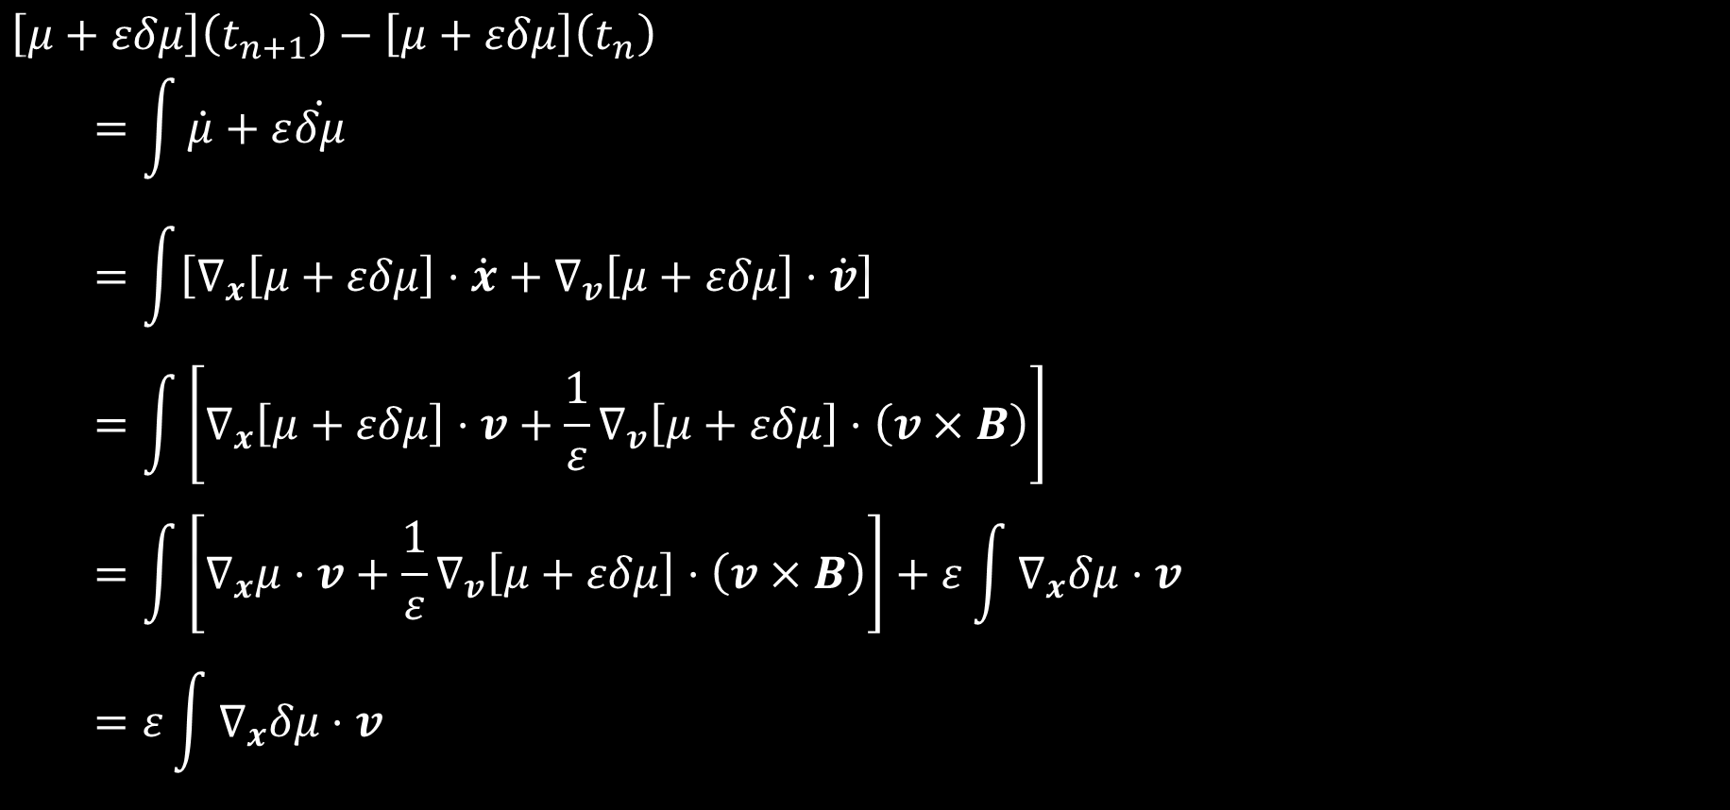
$$\left[μ+εδμ\right]\left(t_{n+1}\right)−\left[μ+εδμ\right]\left(t_{n}\right)$$
$$=\int{\dot{μ}+ε\dot{δμ}}$$
$$=\int{\left[∇_{x}\left[μ+εδμ\right]⋅\dot{x}+∇_{v}\left[μ+εδμ\right]⋅\dot{v}\right]}$$
$$=\int{\left[∇_{x}\left[μ+εδμ\right]⋅v+\frac{1}{ε}∇_{v}\left[μ+εδμ\right]⋅\left(v×B\right)\right]}$$
$$=\int{\left[∇_{x}μ⋅v+\frac{1}{ε}∇_{v}\left[μ+εδμ\right]⋅\left(v×B\right)\right]}+ε\int{∇_{x}δμ⋅v}$$
$$=ε\int{∇_{x}δμ⋅v}$$

Slide 46
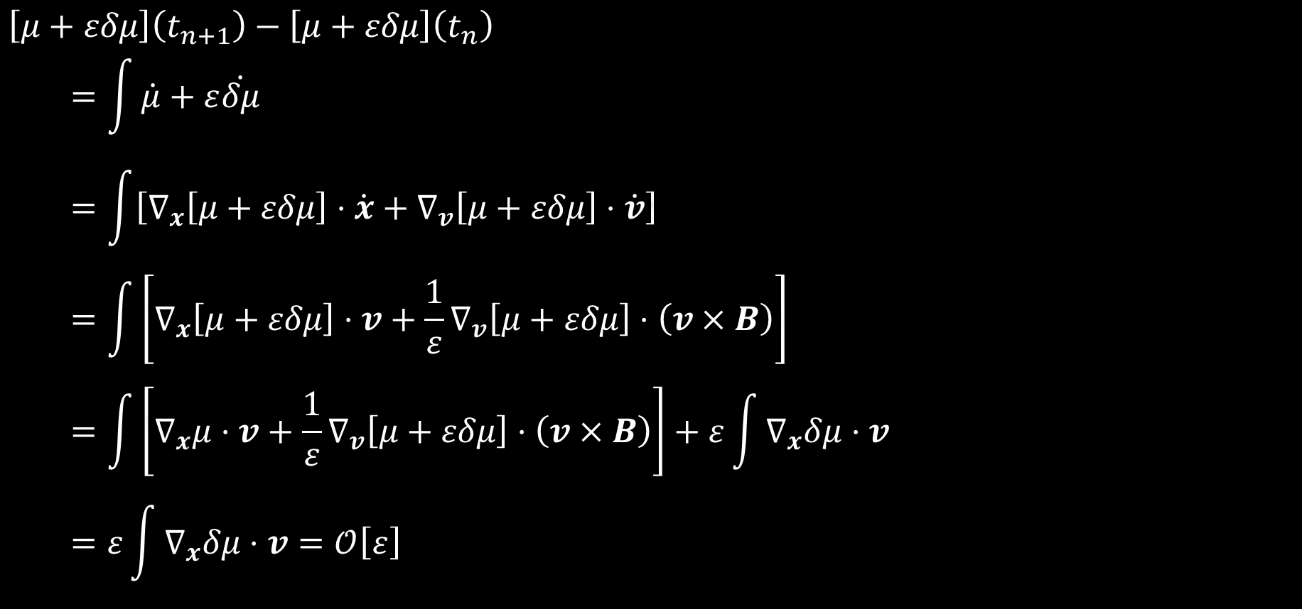
$$\left[μ+εδμ\right]\left(t_{n+1}\right)−\left[μ+εδμ\right]\left(t_{n}\right)$$
$$=\int{\dot{μ}+ε\dot{δμ}}$$
$$=\int{\left[∇_{x}\left[μ+εδμ\right]⋅\dot{x}+∇_{v}\left[μ+εδμ\right]⋅\dot{v}\right]}$$
$$=\int{\left[∇_{x}\left[μ+εδμ\right]⋅v+\frac{1}{ε}∇_{v}\left[μ+εδμ\right]⋅\left(v×B\right)\right]}$$
$$=\int{\left[∇_{x}μ⋅v+\frac{1}{ε}∇_{v}\left[μ+εδμ\right]⋅\left(v×B\right)\right]}+ε\int{∇_{x}δμ⋅v}$$
$$=ε\int{∇_{x}δμ⋅v}=𝒪\left[ε\right]$$

Slide 47
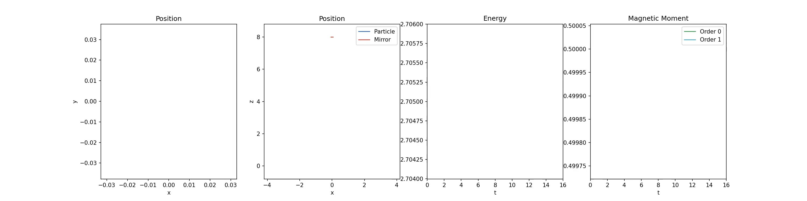

Slide 49
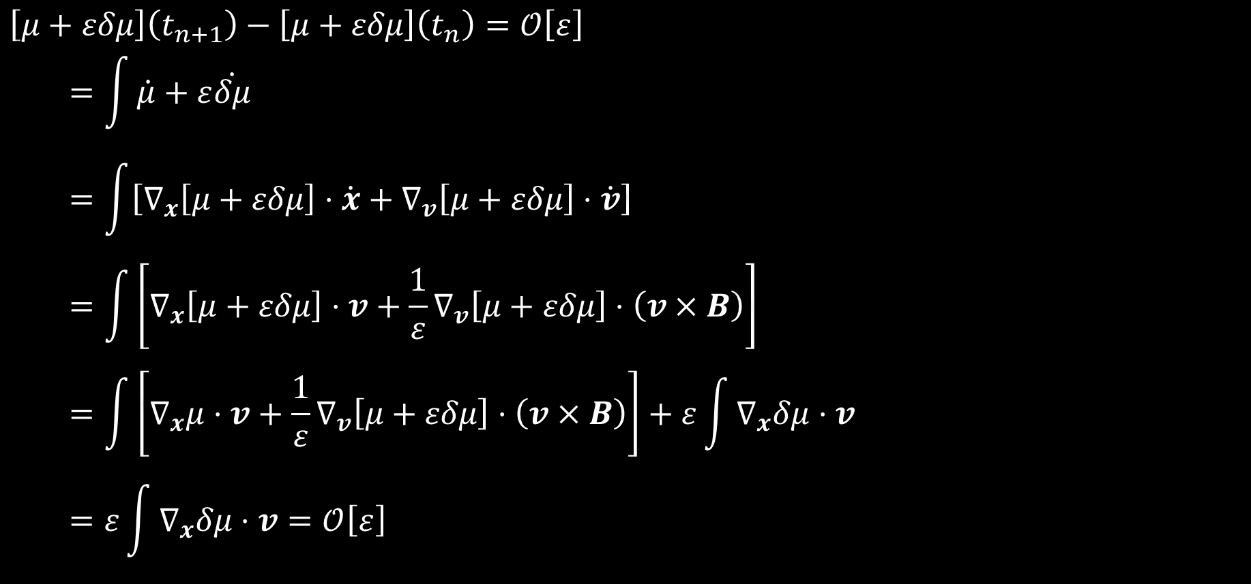
$$\left[μ+εδμ\right]\left(t_{n+1}\right)−\left[μ+εδμ\right]\left(t_{n}\right)=𝒪\left[ε\right]$$
$$=\int{\dot{μ}+ε\dot{δμ}}$$
$$=\int{\left[∇_{x}\left[μ+εδμ\right]⋅\dot{x}+∇_{v}\left[μ+εδμ\right]⋅\dot{v}\right]}$$
$$=\int{\left[∇_{x}\left[μ+εδμ\right]⋅v+\frac{1}{ε}∇_{v}\left[μ+εδμ\right]⋅\left(v×B\right)\right]}$$
$$=\int{\left[∇_{x}μ⋅v+\frac{1}{ε}∇_{v}\left[μ+εδμ\right]⋅\left(v×B\right)\right]}+ε\int{∇_{x}δμ⋅v}$$
$$=ε\int{∇_{x}δμ⋅v}=𝒪\left[ε\right]$$

Slide 50

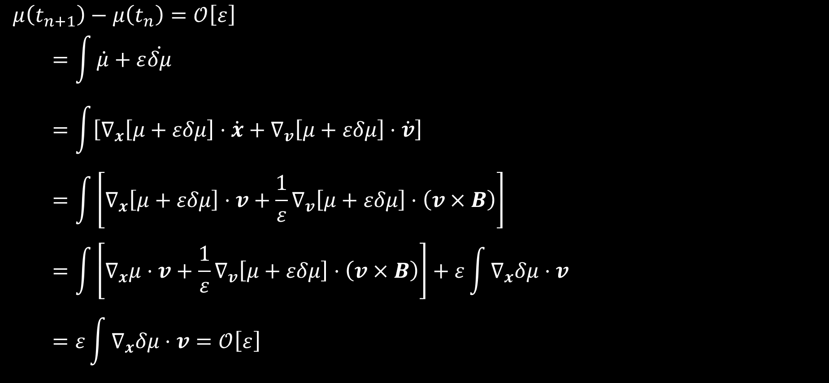
$$μ\left(t_{n+1}\right)−μ\left(t_{n}\right)=𝒪\left[ε\right]$$
$$=\int{\dot{μ}+ε\dot{δμ}}$$
$$=\int{\left[∇_{x}\left[μ+εδμ\right]⋅\dot{x}+∇_{v}\left[μ+εδμ\right]⋅\dot{v}\right]}$$
$$=\int{\left[∇_{x}\left[μ+εδμ\right]⋅v+\frac{1}{ε}∇_{v}\left[μ+εδμ\right]⋅\left(v×B\right)\right]}$$
$$=\int{\left[∇_{x}μ⋅v+\frac{1}{ε}∇_{v}\left[μ+εδμ\right]⋅\left(v×B\right)\right]}+ε\int{∇_{x}δμ⋅v}$$
$$=ε\int{∇_{x}δμ⋅v}=𝒪\left[ε\right]$$

Slide 51
To preserve the structure…
…preserve the proof
Notes:
Can we preserve this proof?

Slide 52
$$\dot{x}=v, \dot{v}=\frac{1}{ε}v×B$$
$$\left(\begin{matrix}\dot{x} \\ \dot{v}\end{matrix}\right)=\left(\begin{matrix}0 & I \\ I & −\frac{1}{ε}B×\end{matrix}\right)\left(\begin{matrix}0 \\ v\end{matrix}\right)=\left(\begin{matrix}0 & I \\ I & −\frac{1}{ε}B×\end{matrix}\right)∇ℋ$$
Scheme #1 (Mean value discrete gradient)
Find $x_{n+1},v_{n+1}∈ℝ^{3}$ s.t.
$$\frac{1}{Δt}\left(x_{n+1}−x_{n}\right)=v_{n+1/2}, \frac{1}{Δt}\left(v_{n+1}−v_{n}\right)=\frac{1}{ε}v_{n+1/2}×B\left(x_{n}\right)$$
Notes:
Let’s see what goes wrong with discrete gradient…

Slide 53
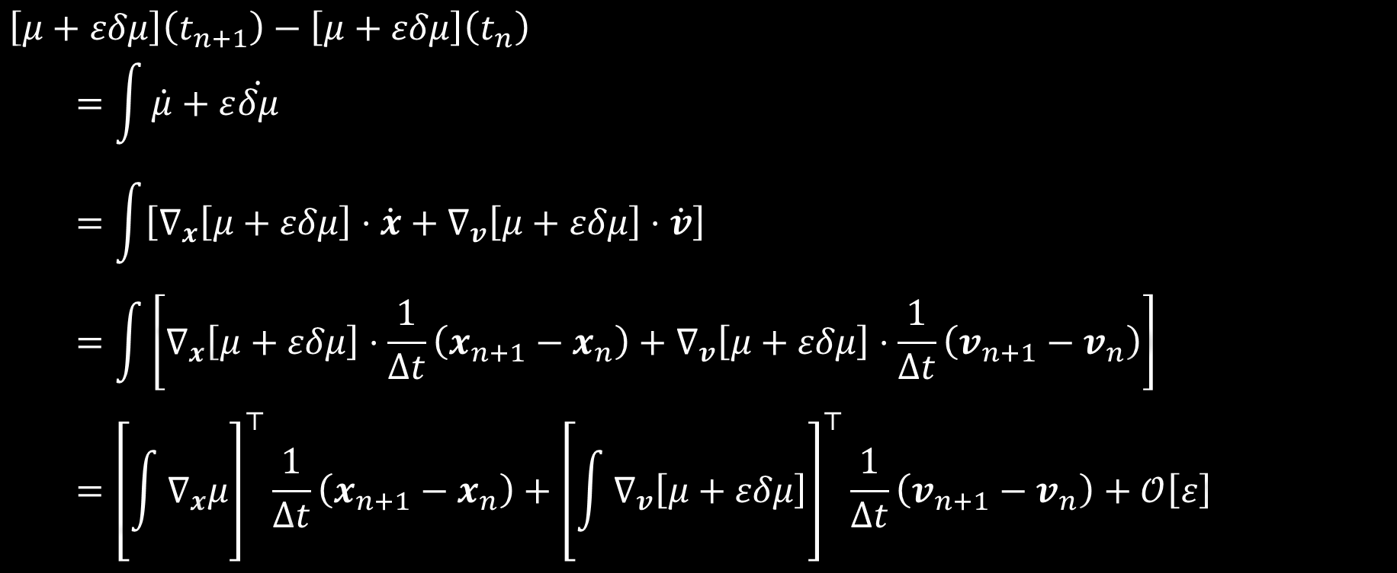
$$\left[μ+εδμ\right]\left(t_{n+1}\right)−\left[μ+εδμ\right]\left(t_{n}\right)$$
$$=\int{\dot{μ}+ε\dot{δμ}}$$
$$=\int{\left[∇_{x}\left[μ+εδμ\right]⋅\dot{x}+∇_{v}\left[μ+εδμ\right]⋅\dot{v}\right]}$$
$$=\int{\left[∇_{x}\left[μ+εδμ\right]⋅\frac{1}{Δt}\left(x_{n+1}−x_{n}\right)+∇_{v}\left[μ+εδμ\right]⋅\frac{1}{Δt}\left(v_{n+1}−v_{n}\right)\right]}$$
$$={\left[\int{∇_{x}μ}\right]}^{⊤}\frac{1}{Δt}\left(x_{n+1}−x_{n}\right)+{\left[\int{∇_{v}\left[μ+εδμ\right]}\right]}^{⊤}\frac{1}{Δt}\left(v_{n+1}−v_{n}\right)+𝒪\left[ε\right]$$

Slide 54
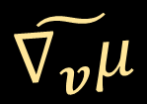
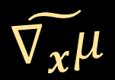
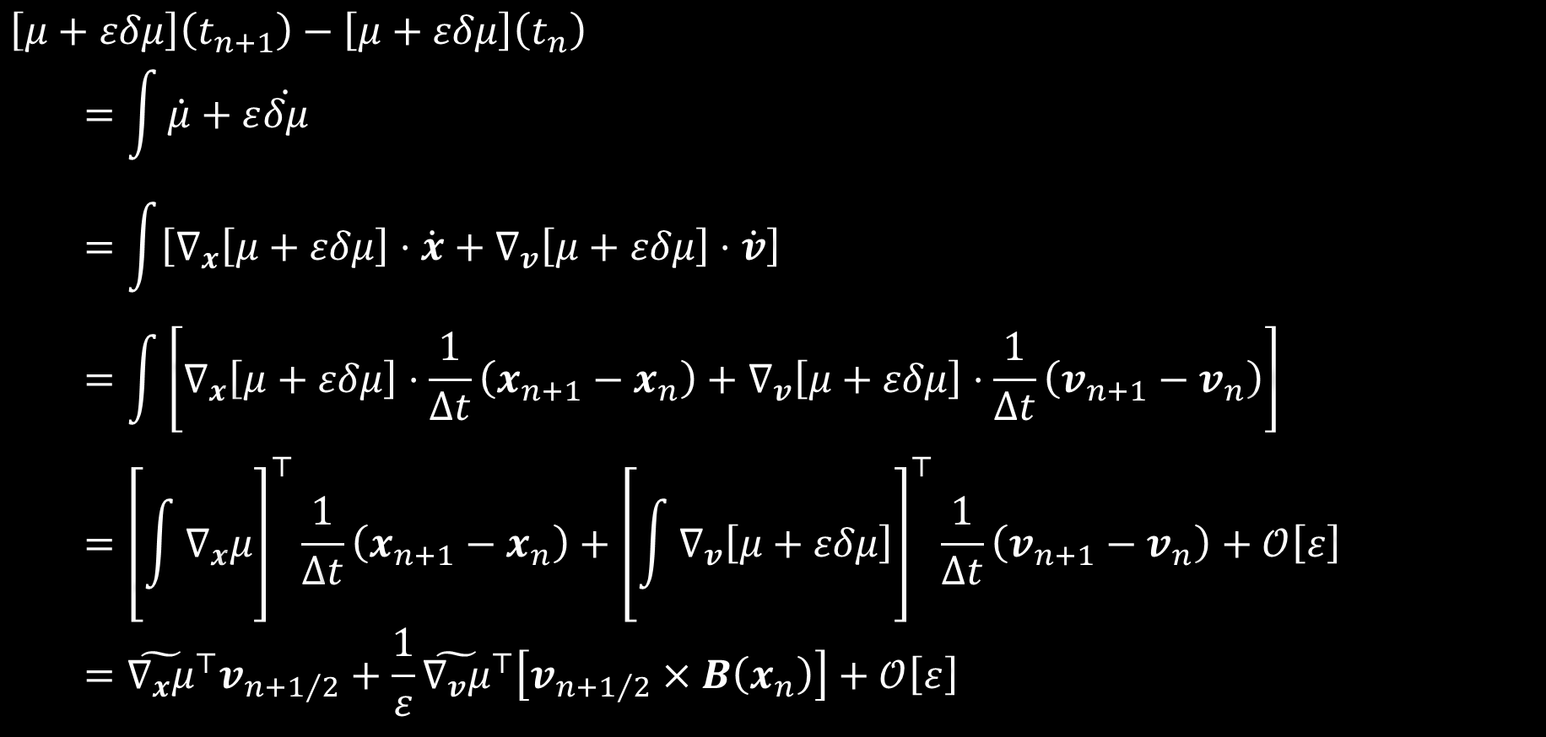
$$\left[μ+εδμ\right]\left(t_{n+1}\right)−\left[μ+εδμ\right]\left(t_{n}\right)$$
$$=\int{\dot{μ}+ε\dot{δμ}}$$
$$=\int{\left[∇_{x}\left[μ+εδμ\right]⋅\dot{x}+∇_{v}\left[μ+εδμ\right]⋅\dot{v}\right]}$$
$$=\int{\left[∇_{x}\left[μ+εδμ\right]⋅\frac{1}{Δt}\left(x_{n+1}−x_{n}\right)+∇_{v}\left[μ+εδμ\right]⋅\frac{1}{Δt}\left(v_{n+1}−v_{n}\right)\right]}$$
$$={\left[\int{∇_{x}μ}\right]}^{⊤}\frac{1}{Δt}\left(x_{n+1}−x_{n}\right)+{\left[\int{∇_{v}\left[μ+εδμ\right]}\right]}^{⊤}\frac{1}{Δt}\left(v_{n+1}−v_{n}\right)+𝒪\left[ε\right]$$
$$={\tilde{∇_{x}μ}}^{⊤}v_{n+1/2}+\frac{1}{ε}{\tilde{∇_{v}μ}}^{⊤}\left[v_{n+1/2}×B\left(x_{n}\right)\right]+𝒪\left[ε\right]$$
$$\tilde{∇_{x}μ}$$
$$\tilde{∇_{v}μ}$$

Slide 55

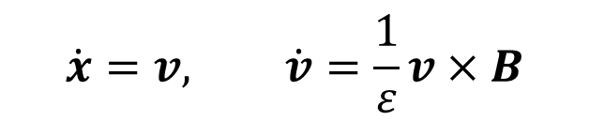
$$\dot{x}=v, \dot{v}=\frac{1}{ε}v×B$$
Lemma (Vector decomposition)
Can write any $x$ in components parallel & perpendicular to any $y$,
$${\left\|y\right\|}^{2}x=\left(x⋅y\right)y−\left(x×y\right)×y$$
$${\left\|∇_{x}μ\right\|}^{2}v=\left(v⋅∇_{x}μ\right)∇_{x}μ−\left(v×∇_{x}μ\right)×∇_{x}μ$$

Slide 56

$$v$$
Definition (Magnetic moment)
$$∇_{x}μ⋅v+\frac{1}{ε}\left[∇_{v}μ+ε∇_{v}δμ\right]⋅\left(v×B\right)=0$$
$$μ≔\frac{1}{2B}v_{⊥}^{2}$$
$$b_{⊥}$$
$$B$$
$$v_{⊥}$$
$$b_{||}$$
$$b_{∗}$$
$$\left(≔b_{||}×b_{⊥}\right)$$
$$v_{||}$$
$$∇_{v}μ⋅\left(v×B\right)=0$$
$$B$$
$$∇_{x}μ⋅v+∇_{v}δμ⋅\left(v×B\right)=0$$
Definition (Magnetic moment correction)
$$δμ≔\frac{1}{B^{3}}\left[v_{||}^{2}v_{⊥}\left(\frac{1}{4}b_{⊥}⊗b_{∗}+\frac{1}{4}b_{∗}⊗b_{⊥}+b_{∗}⊗b_{||}\right)+\frac{1}{2}v_{||}^{3}\left(b_{||}⊗b_{∗}\right)\right]:∇B$$

Slide 57
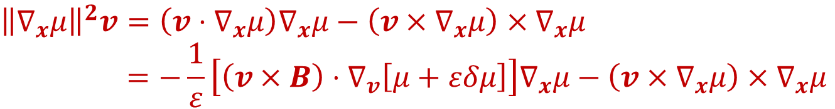
$$\dot{x}=v, \dot{v}=\frac{1}{ε}v×B$$
Lemma (Vector decomposition)
Can write any $x$ in components parallel & perpendicular to any $y$,
$${\left\|y\right\|}^{2}x=\left(x⋅y\right)y−\left(x×y\right)×y$$
$${\left\|∇_{x}μ\right\|}^{2}v=\left(v⋅∇_{x}μ\right)∇_{x}μ−\left(v×∇_{x}μ\right)×∇_{x}μ$$
$${\left\|∇_{x}μ\right\|}^{2}\dot{x}=−\frac{1}{ε}\left[\left(v×B\right)⋅∇_{v}\left[μ+εδμ\right]\right]∇_{x}μ−\left(v×∇_{x}μ\right)×∇_{x}μ$$

Slide 58
$$\dot{x}=v, \dot{v}=\frac{1}{ε}v×B$$
Lemma (Vector decomposition)
Can write any $x$ in components parallel & perpendicular to any $y$,
$${\left\|y\right\|}^{2}x=\left(x⋅y\right)y−\left(x×y\right)×y$$
$${\left\|∇_{x}μ\right\|}^{2}v=\left(v⋅∇_{x}μ\right)∇_{x}μ−\left(v×∇_{x}μ\right)×∇_{x}μ$$
$${\left\|∇_{x}μ\right\|}^{2}\dot{x}=−\frac{1}{ε}\left[\left(v×B\right)⋅∇_{v}\left[μ+εδμ\right]\right]∇_{x}μ−\left(v×∇_{x}μ\right)×∇_{x}μ$$

Slide 59
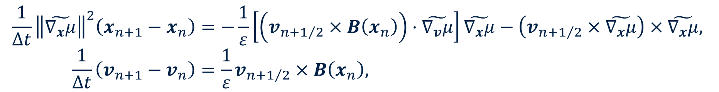
$$\dot{x}=v, \dot{v}=\frac{1}{ε}v×B$$
$${\left\|∇_{x}μ\right\|}^{2}\dot{x}=−\frac{1}{ε}\left[\left(v×B\right)⋅∇_{v}\left[μ+εδμ\right]\right]∇_{x}μ−\left(v×∇_{x}μ\right)×∇_{x}μ$$
Scheme #2 (Mean-value adiabatic discrete gradient)
Find $x_{n+1},v_{n+1}∈ℝ^{3}$ s.t.
$$\frac{1}{Δt}{\left\|\tilde{∇_{x}μ}\right\|}^{2}\left(x_{n+1}−x_{n}\right)=−\frac{1}{ε}\left[\left(v_{n+1/2}×B\left(x_{n}\right)\right)⋅\tilde{∇_{v}μ}\right]\tilde{∇_{x}μ}−\left(v_{n+1/2}×\tilde{∇_{x}μ}\right)×\tilde{∇_{x}μ},$$
$$\frac{1}{Δt}\left(v_{n+1}−v_{n}\right)=\frac{1}{ε}v_{n+1/2}×B\left(x_{n}\right),$$
where $\tilde{∇_{x}μ}≔\int_{t_{n}}^{t_{n+1}}{∇_{x}μ}$ and $\tilde{∇_{v}μ}≔\int_{t_{n}}^{t_{n+1}}{\left[∇_{v}μ+ε∇_{v}δμ\right]}$

Slide 60
$$\dot{x}=v, \dot{v}=\frac{1}{ε}v×B$$
$${\left\|∇_{x}μ\right\|}^{2}\dot{x}=−\frac{1}{ε}\left[\left(v×B\right)⋅∇_{v}\left[μ+εδμ\right]\right]∇_{x}μ−\left(v×∇_{x}μ\right)×∇_{x}μ$$
Scheme #2 (Mean-value adiabatic discrete gradient)
Find $x_{n+1},v_{n+1}∈ℝ^{3}$ s.t.
$$\frac{1}{Δt}{\left\|\tilde{∇_{x}μ}\right\|}^{2}\left(x_{n+1}−x_{n}\right)=−\frac{1}{ε}\left[\left(v_{n+1/2}×B\left(x_{n}\right)\right)⋅\tilde{∇_{v}μ}\right]\tilde{∇_{x}μ}−\left(v_{n+1/2}×\tilde{∇_{x}μ}\right)×\tilde{∇_{x}μ},$$
$$\frac{1}{Δt}\left(v_{n+1}−v_{n}\right)=\frac{1}{ε}v_{n+1/2}×B\left(x_{n}\right),$$
where $\tilde{∇_{x}μ}≔\int_{t_{n}}^{t_{n+1}}{∇_{x}μ}$ and $\tilde{∇_{v}μ}≔\int_{t_{n}}^{t_{n+1}}{\left[∇_{v}μ+ε∇_{v}δμ\right]}$

Slide 61
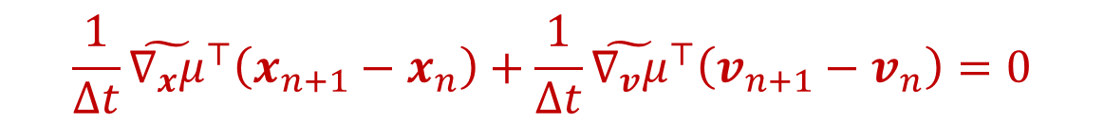
$$\frac{1}{Δt}{\left\|\tilde{∇_{x}μ}\right\|}^{2}{\tilde{∇_{x}μ}}^{⊤}\left(x_{n+1}−x_{n}\right)=−\frac{1}{ε}\left[\left(v_{n+1/2}×B\left(x_{n}\right)\right)⋅\tilde{∇_{v}μ}\right]{\left\|\tilde{∇_{x}μ}\right\|}^{2}$$
$$\frac{1}{Δt}{\tilde{∇_{x}μ}}^{⊤}\left(x_{n+1}−x_{n}\right)=−\frac{1}{ε}\left(v_{n+1/2}×B\left(x_{n}\right)\right)⋅\tilde{∇_{v}μ}=−\frac{1}{Δt}{\tilde{∇_{v}μ}}^{⊤}\left(v_{n+1}−v_{n}\right)$$
$$\frac{1}{Δt}{\tilde{∇_{x}μ}}^{⊤}\left(x_{n+1}−x_{n}\right)+\frac{1}{Δt}{\tilde{∇_{v}μ}}^{⊤}\left(v_{n+1}−v_{n}\right)=0$$
Scheme #2 (Mean-value adiabatic discrete gradient)
Find $x_{n+1},v_{n+1}∈ℝ^{3}$ s.t.
$$\frac{1}{Δt}{\left\|\tilde{∇_{x}μ}\right\|}^{2}\left(x_{n+1}−x_{n}\right)=−\frac{1}{ε}\left[\left(v_{n+1/2}×B\left(x_{n}\right)\right)⋅\tilde{∇_{v}μ}\right]\tilde{∇_{x}μ}−\left(v_{n+1/2}×\tilde{∇_{x}μ}\right)×\tilde{∇_{x}μ},$$
$$\frac{1}{Δt}\left(v_{n+1}−v_{n}\right)=\frac{1}{ε}v_{n+1/2}×B\left(x_{n}\right),$$
where $\tilde{∇_{x}μ}≔\int_{t_{n}}^{t_{n+1}}{∇_{x}μ}$ and $\tilde{∇_{v}μ}≔\int_{t_{n}}^{t_{n+1}}{\left[∇_{v}μ+ε∇_{v}δμ\right]}$

Slide 62
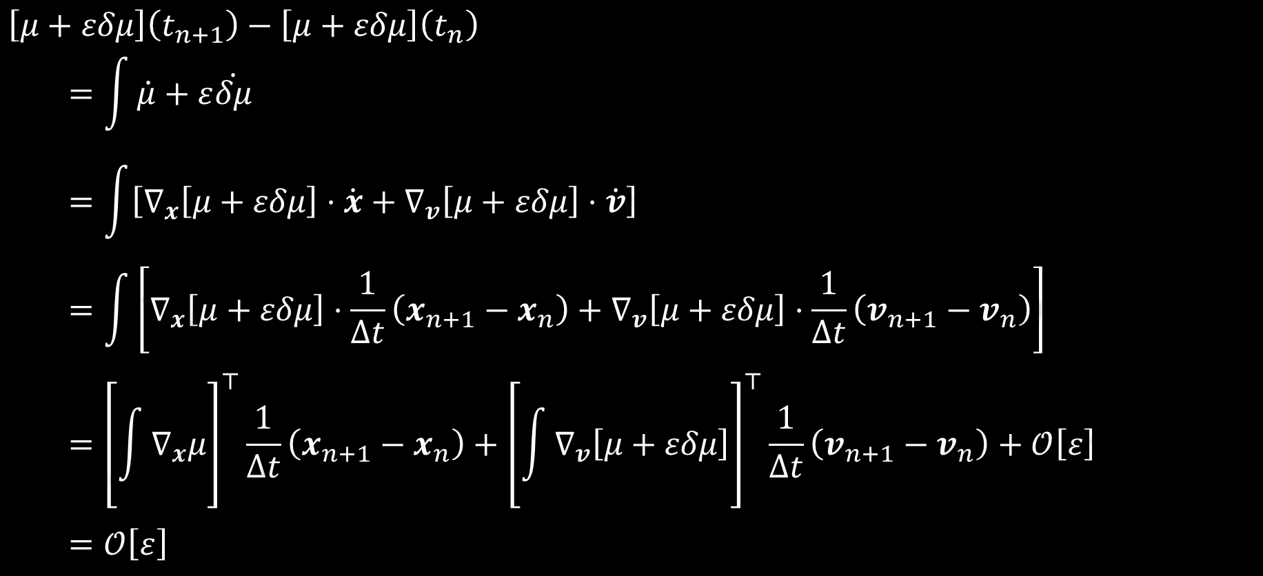
$$\left[μ+εδμ\right]\left(t_{n+1}\right)−\left[μ+εδμ\right]\left(t_{n}\right)$$
$$=\int{\dot{μ}+ε\dot{δμ}}$$
$$=\int{\left[∇_{x}\left[μ+εδμ\right]⋅\dot{x}+∇_{v}\left[μ+εδμ\right]⋅\dot{v}\right]}$$
$$=\int{\left[∇_{x}\left[μ+εδμ\right]⋅\frac{1}{Δt}\left(x_{n+1}−x_{n}\right)+∇_{v}\left[μ+εδμ\right]⋅\frac{1}{Δt}\left(v_{n+1}−v_{n}\right)\right]}$$
$$={\left[\int{∇_{x}μ}\right]}^{⊤}\frac{1}{Δt}\left(x_{n+1}−x_{n}\right)+{\left[\int{∇_{v}\left[μ+εδμ\right]}\right]}^{⊤}\frac{1}{Δt}\left(v_{n+1}−v_{n}\right)+𝒪\left[ε\right]$$
$$=𝒪\left[ε\right]$$
$$\tilde{∇_{x}μ}$$
$$\tilde{∇_{v}μ}$$

Slide 63
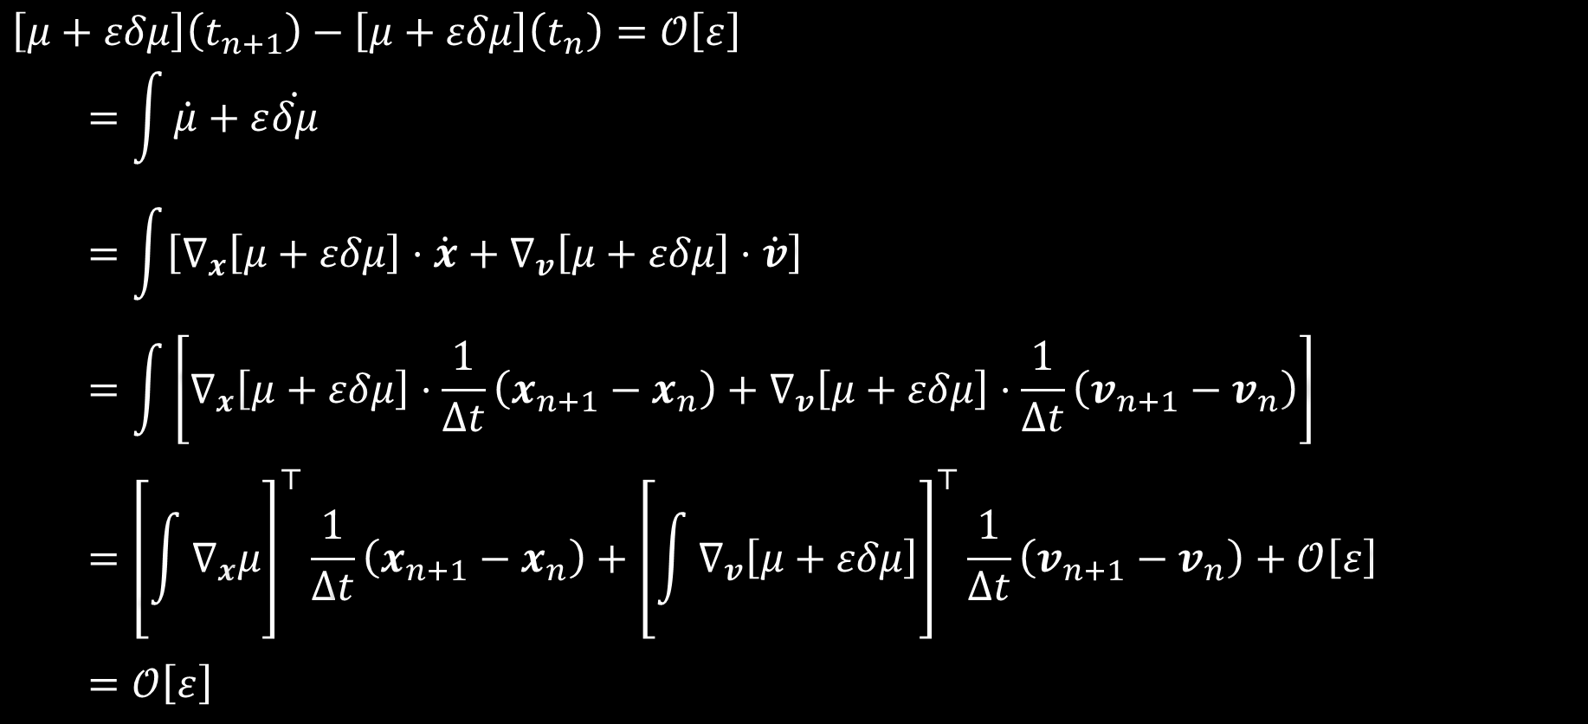
$$\left[μ+εδμ\right]\left(t_{n+1}\right)−\left[μ+εδμ\right]\left(t_{n}\right)=𝒪\left[ε\right]$$
$$=\int{\dot{μ}+ε\dot{δμ}}$$
$$=\int{\left[∇_{x}\left[μ+εδμ\right]⋅\dot{x}+∇_{v}\left[μ+εδμ\right]⋅\dot{v}\right]}$$
$$=\int{\left[∇_{x}\left[μ+εδμ\right]⋅\frac{1}{Δt}\left(x_{n+1}−x_{n}\right)+∇_{v}\left[μ+εδμ\right]⋅\frac{1}{Δt}\left(v_{n+1}−v_{n}\right)\right]}$$
$$={\left[\int{∇_{x}μ}\right]}^{⊤}\frac{1}{Δt}\left(x_{n+1}−x_{n}\right)+{\left[\int{∇_{v}\left[μ+εδμ\right]}\right]}^{⊤}\frac{1}{Δt}\left(v_{n+1}−v_{n}\right)+𝒪\left[ε\right]$$
$$=𝒪\left[ε\right]$$
$$\tilde{∇_{x}μ}$$
$$\tilde{∇_{v}μ}$$

Slide 64
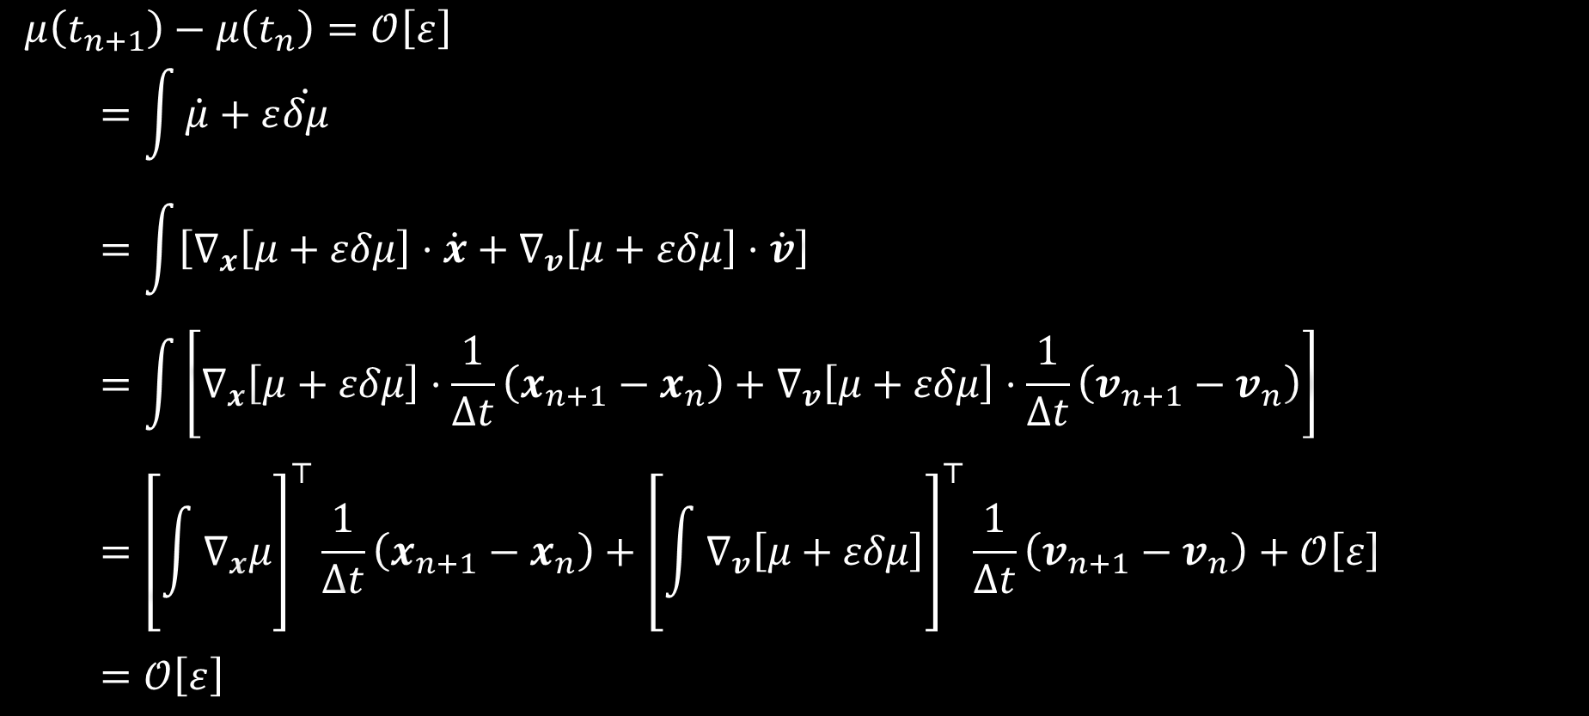
$$μ\left(t_{n+1}\right)−μ\left(t_{n}\right)=𝒪\left[ε\right]$$
$$=\int{\dot{μ}+ε\dot{δμ}}$$
$$=\int{\left[∇_{x}\left[μ+εδμ\right]⋅\dot{x}+∇_{v}\left[μ+εδμ\right]⋅\dot{v}\right]}$$
$$=\int{\left[∇_{x}\left[μ+εδμ\right]⋅\frac{1}{Δt}\left(x_{n+1}−x_{n}\right)+∇_{v}\left[μ+εδμ\right]⋅\frac{1}{Δt}\left(v_{n+1}−v_{n}\right)\right]}$$
$$={\left[\int{∇_{x}μ}\right]}^{⊤}\frac{1}{Δt}\left(x_{n+1}−x_{n}\right)+{\left[\int{∇_{v}\left[μ+εδμ\right]}\right]}^{⊤}\frac{1}{Δt}\left(v_{n+1}−v_{n}\right)+𝒪\left[ε\right]$$
$$=𝒪\left[ε\right]$$
$$\tilde{∇_{x}μ}$$
$$\tilde{∇_{v}μ}$$

Slide 65
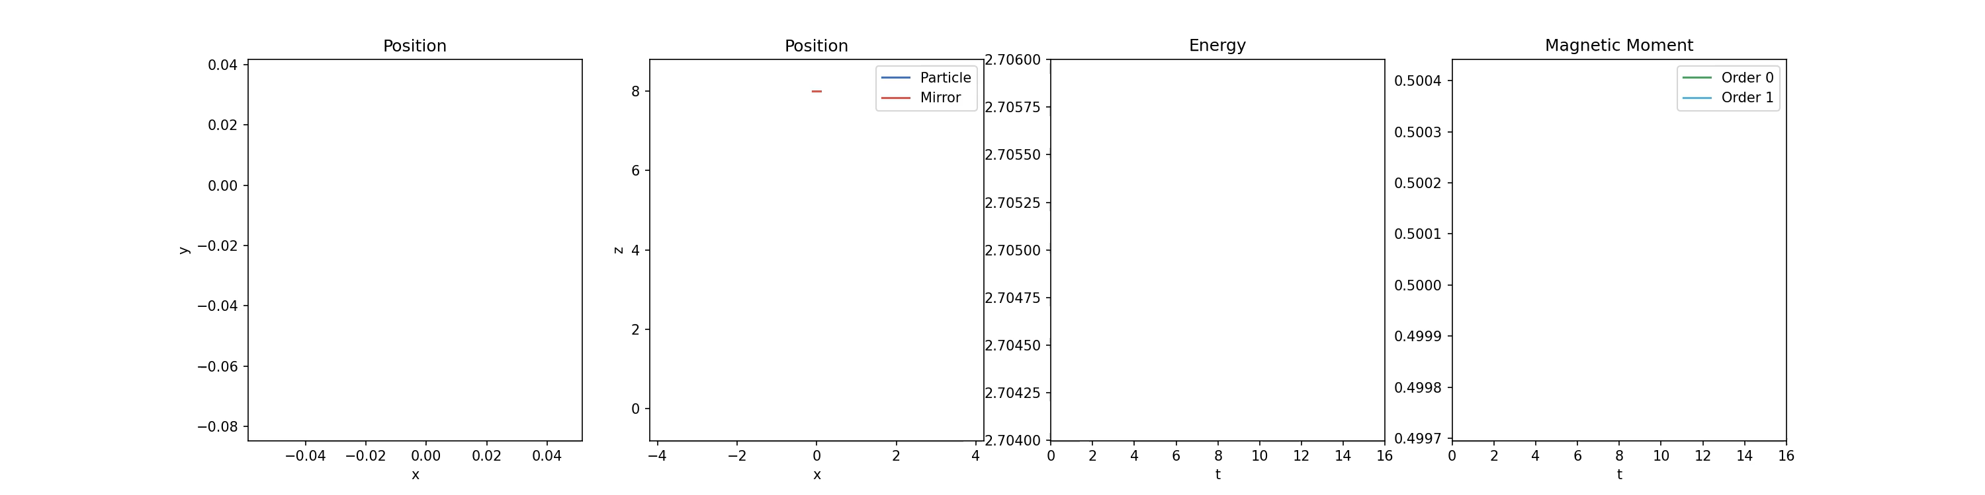

Slide 66
4. THE GUIDING CENTRE

Slide 67
4. THE GUIDING CENTRE* (*potentially…)

Slide 68



$$v$$
Definition (Guiding centre correction)
$$ξ≔\frac{1}{B^{2}}v×B$$
$$b_{⊥}$$
$$B$$
$$v_{⊥}$$
$$b_{||}$$
$$b_{∗}$$
$$\left(≔b_{||}×b_{⊥}\right)$$
$$v_{||}$$
$$∇_{v}ξ⋅\left(v×B\right)=−v_{⊥}b_{⊥}$$
$$B$$
$∇_{x}ξ⋅v+∇_{v}δξ⋅\left(v×B\right)=$ “Drifts”
Definition (Guiding centre correction correction)
$δξ≔$ “Some garbage”

Slide 69

$$\left[x+εξ+ε^{2}δξ\right]\left(t_{n+1}\right)−\left[x+εξ+ε^{2}δξ\right]\left(t_{n}\right)$$
$$=\int{\dot{x}+ε\dot{ξ}+ε^{2}\dot{δξ}}$$
$$=\int{\dot{x}+ε∇_{x}\left[ξ+εδξ\right]⋅\dot{x}+ε∇_{v}\left[ξ+εδξ\right]⋅\dot{v}}$$
$$=\int{v+ε∇_{x}\left[ξ+εδξ\right]⋅v+∇_{v}\left[ξ+εδξ\right]⋅\left(v×B\right)}$$
$$=\int{v+ε∇_{x}ξ⋅v+∇_{v}\left[ξ+εδξ\right]⋅\left(v×B\right)}+ε^{2}\int{∇_{x}δξ⋅v}$$

Slide 70

$$v$$
Definition (Guiding centre correction)
$$ξ≔\frac{1}{B^{2}}v×B$$
$$v+ε∇_{x}ξ⋅v+∇_{v}\left[ξ+εδξ\right]⋅\left(v×B\right)$$
$=v_{||}b_{||}+ε$ “Drifts”
$$b_{⊥}$$
$$B$$
$$v_{⊥}$$
$$b_{||}$$
$$b_{∗}$$
$$\left(≔b_{||}×b_{⊥}\right)$$
$$v_{||}$$
$$∇_{v}ξ⋅\left(v×B\right)=−v_{⊥}b_{⊥}$$
$$B$$
$∇_{x}ξ⋅v+∇_{v}δξ⋅\left(v×B\right)=$ “Drifts”
Definition (Guiding centre correction correction)
$δξ≔$ “Some garbage”

Slide 71

$$\left[x+εξ+ε^{2}δξ\right]\left(t_{n+1}\right)−\left[x+εξ+ε^{2}δξ\right]\left(t_{n}\right)$$
$$=\int{\dot{x}+ε\dot{ξ}+ε^{2}\dot{δξ}}$$
$$=\int{\dot{x}+ε∇_{x}\left[ξ+εδξ\right]⋅\dot{x}+ε∇_{v}\left[ξ+εδξ\right]⋅\dot{v}}$$
$$=\int{v+ε∇_{x}\left[ξ+εδξ\right]⋅v+∇_{v}\left[ξ+εδξ\right]⋅\left(v×B\right)}$$
$$=\int{v+ε∇_{x}ξ⋅v+∇_{v}\left[ξ+εδξ\right]⋅\left(v×B\right)}+ε^{2}\int{∇_{x}δξ⋅v}$$
$$=\int{v_{||}b_{||}+ε "Drifts"}+𝒪\left[ε^{2}\right]$$

Slide 72

$$\left[x+εξ+ε^{2}δξ\right]\left(t_{n+1}\right)−\left[x+εξ+ε^{2}δξ\right]\left(t_{n}\right)=\int{v_{||}b_{||}+ε "Drifts"}+𝒪\left[ε^{2}\right]$$
$$=\int{\dot{x}+ε\dot{ξ}+ε^{2}\dot{δξ}}$$
$$=\int{\dot{x}+ε∇_{x}\left[ξ+εδξ\right]⋅\dot{x}+ε∇_{v}\left[ξ+εδξ\right]⋅\dot{v}}$$
$$=\int{v+ε∇_{x}\left[ξ+εδξ\right]⋅v+∇_{v}\left[ξ+εδξ\right]⋅\left(v×B\right)}$$
$$=\int{v+ε∇_{x}ξ⋅v+∇_{v}\left[ξ+εδξ\right]⋅\left(v×B\right)}+ε^{2}\int{∇_{x}δξ⋅v}$$
$$=\int{v_{||}b_{||}+ε "Drifts"}+𝒪\left[ε^{2}\right]$$

Slide 73
$$\left[x+εξ\right]\left(t_{n+1}\right)−\left[x+εξ\right]\left(t_{n}\right)=\int{v_{||}b_{||}+ε "Drifts"}+𝒪\left[ε^{2}\right]$$
$$=\int{\dot{x}+ε\dot{ξ}+ε^{2}\dot{δξ}}$$
$$=\int{\dot{x}+ε∇_{x}\left[ξ+εδξ\right]⋅\dot{x}+ε∇_{v}\left[ξ+εδξ\right]⋅\dot{v}}$$
$$=\int{v+ε∇_{x}\left[ξ+εδξ\right]⋅v+∇_{v}\left[ξ+εδξ\right]⋅\left(v×B\right)}$$
$$=\int{v+ε∇_{x}ξ⋅v+∇_{v}\left[ξ+εδξ\right]⋅\left(v×B\right)}+ε^{2}\int{∇_{x}δξ⋅v}$$
$$=\int{v_{||}b_{||}+ε "Drifts"}+𝒪\left[ε^{2}\right]$$

Slide 74
To preserve the structure…
…preserve the proof
Notes:
Can we preserve this proof?

Slide 75
$$\dot{x}=v, \dot{v}=\frac{1}{ε}v×B$$
$${\left\|∇_{x}μ\right\|}^{2}\dot{x}=−\frac{1}{ε}\left[\left(v×B\right)⋅∇_{v}\left[μ+εδμ\right]\right]∇_{x}μ−\left(v×∇_{x}μ\right)×∇_{x}μ$$
Scheme #2 (Mean-value adiabatic discrete gradient)
Find $x_{n+1},v_{n+1}∈ℝ^{3}$ s.t.
$$\frac{1}{Δt}{\left\|\tilde{∇_{x}μ}\right\|}^{2}\left(x_{n+1}−x_{n}\right)=−\frac{1}{ε}\left[\left(v_{n+1/2}×B\left(x_{n}\right)\right)⋅\tilde{∇_{v}μ}\right]\tilde{∇_{x}μ}−\left(v_{n+1/2}×\tilde{∇_{x}μ}\right)×\tilde{∇_{x}μ},$$
$$\frac{1}{Δt}\left(v_{n+1}−v_{n}\right)=\frac{1}{ε}v_{n+1/2}×B\left(x_{n}\right),$$
where $\tilde{∇_{x}μ}≔\int_{t_{n}}^{t_{n+1}}{∇_{x}μ}$ and $\tilde{∇_{v}μ}≔\int_{t_{n}}^{t_{n+1}}{\left[∇_{v}μ+ε∇_{v}δμ\right]}$

Slide 76


$$\left[x+εξ+ε^{2}δξ\right]\left(t_{n+1}\right)−\left[x+εξ+ε^{2}δξ\right]\left(t_{n}\right)$$
$$=\left(x_{n+1}−x_{n}\right)+ε\int{\dot{ξ}+ε\dot{δξ}}$$
$$=\left(x_{n+1}−x_{n}\right)+ε\int{∇_{x}\left[ξ+εδξ\right]⋅\dot{x}+∇_{v}\left[ξ+εδξ\right]⋅\dot{v}}$$
$$=\left(x_{n+1}−x_{n}\right)+ε\int{\left[∇_{x}\left[ξ+εδξ\right]⋅\frac{1}{Δt}\left(x_{n+1}−x_{n}\right)+∇_{v}\left[ξ+εδξ\right]⋅\frac{1}{Δt}\left(v_{n+1}−v_{n}\right)\right]}$$
$$=\left(x_{n+1}−x_{n}\right)+ε{\left[\int{∇_{x}ξ}\right]}^{⊤}\frac{1}{Δt}\left(x_{n+1}−x_{n}\right)$$
$$+{\left[\int{∇_{v}\left[ξ+εδξ\right]}\right]}^{⊤}\frac{1}{Δt}\left(v_{n+1}−v_{n}\right)+𝒪\left[ε^{2}\right]$$

Slide 77


$$\left[x+εξ+ε^{2}δξ\right]\left(t_{n+1}\right)−\left[x+εξ+ε^{2}δξ\right]\left(t_{n}\right)$$
$$=\left(x_{n+1}−x_{n}\right)+ε\int{\dot{ξ}+ε\dot{δξ}}$$
$$=\left(x_{n+1}−x_{n}\right)+ε\int{∇_{x}\left[ξ+εδξ\right]⋅\dot{x}+∇_{v}\left[ξ+εδξ\right]⋅\dot{v}}$$
$$=\left(x_{n+1}−x_{n}\right)+ε\int{\left[∇_{x}\left[ξ+εδξ\right]⋅\frac{1}{Δt}\left(x_{n+1}−x_{n}\right)+∇_{v}\left[ξ+εδξ\right]⋅\frac{1}{Δt}\left(v_{n+1}−v_{n}\right)\right]}$$
$$=\left(x_{n+1}−x_{n}\right)+ε{\left[\int{∇_{x}ξ}\right]}^{⊤}\frac{1}{Δt}\left(x_{n+1}−x_{n}\right)$$
$$\tilde{∇_{x}ξ}$$
$$+{\left[\int{∇_{v}\left[ξ+εδξ\right]}\right]}^{⊤}\frac{1}{Δt}\left(v_{n+1}−v_{n}\right)+𝒪\left[ε^{2}\right]$$
$$\tilde{∇_{v}ξ}$$

Slide 78



Where do $\tilde{∇_{x}ξ}$ and $\tilde{∇_{v}ξ}$ go to preserve
$$\left(x_{n+1}−x_{n}\right)+ε{\tilde{∇_{x}ξ}}^{⊤}\frac{1}{Δt}\left(x_{n+1}−x_{n}\right)+ε{\tilde{∇_{v}ξ}}^{⊤}\frac{1}{Δt}\left(v_{n+1}−v_{n}\right)$$
$=v_{||}b_{||}+ε$ “Drifts”?
$$\dot{x}=v, \dot{v}=\frac{1}{ε}v×B$$
$${\left\|∇_{x}μ\right\|}^{2}\dot{x}=−\frac{1}{ε}\left[\left(v×B\right)⋅∇_{v}\left[μ+εδμ\right]\right]∇_{x}μ−\left(v×∇_{x}μ\right)×∇_{x}μ$$
Scheme #2 (Mean-value adiabatic discrete gradient)
Find $x_{n+1},v_{n+1}∈ℝ^{3}$ s.t.
$$\frac{1}{Δt}{\left\|\tilde{∇_{x}μ}\right\|}^{2}\left(x_{n+1}−x_{n}\right)=−\frac{1}{ε}\left[\left(v_{n+1/2}×B\left(x_{n}\right)\right)⋅\tilde{∇_{v}μ}\right]\tilde{∇_{x}μ}−\left(v_{n+1/2}×\tilde{∇_{x}μ}\right)×\tilde{∇_{x}μ},$$
$$\frac{1}{Δt}\left(v_{n+1}−v_{n}\right)=\frac{1}{ε}v_{n+1/2}×B\left(x_{n}\right),$$
where $\tilde{∇_{x}μ}≔\int_{t_{n}}^{t_{n+1}}{∇_{x}μ}$ and $\tilde{∇_{v}μ}≔\int_{t_{n}}^{t_{n+1}}{\left[∇_{v}μ+ε∇_{v}δμ\right]}$

Slide 79
THANKS!
borisandrews.github.io
boris.andrews@maths.ox.ac.uk

